Slide 1
Quality Assurance: European and the British Taxonomies
Iftikhar H. Malik

Slide 2
The Roman Baths

Slide 3
BATH

Slide 4
The River Avon

Slide 5
The Georgian Architeture. The Royal Crescent

Slide 6
The Circus

Slide 9
ADELARD OF BATH—10th Century

Slide 13
Nasruddin in Moscow

Slide 15
Outline
Definitional aspects.
Historical Evolution. Various declarations.
Objectives and Imperatives.
Teaching and Learning based on the autonomy of HE Sector.
Student centered or quality centered! Pointers
Quality controls: internal and external. Reviews
Peer Review and Student Satisfaction Surveys (NSS}

Slide 16
What do we mean by Quality Assurance
https://www.youtube.com/watch?v=Jaq8b6mgg98

Slide 17
Historical Evolution
1998: Four education ministers met to celebrate the 800th anniversary of the University of Paris. The Declaration of Sorbonne was made to shun the segmentation in European higher education which was viewed as “outdated”. They proposed to create the European Higher Education Area (EHEA).
1999: At Bologna, the proposal was formalized by 30 countries and is known as The Bologna Declaration.
2003: Ministers met in Berlin to review the Bologna process and called on each country to develop a national framework of qualifications. They also called for an overarching Framework for Qualifications of the Euroepan Higher Education Area, and which is called Bologna Framework.
2005. Meetings in Bergen and Dublin further defined the key elements. The Dublin Descriptors are general statements accommodating individual national traditions with the EHEAF.

Slide 18
The Dublin (March 2004) Descriptors and EQF
The have established five points as criteria:
1-Acquiring knowledge and understanding,
2-Applying knowledge and understanding,
3-Making informed judgments and choices,
4-Communicating knowledge and understanding,
5-Capacity-development to enable continuing learning.
So, the European Qualifications Framework for Lifelong Learning (EQF)—the meta framework-- developed in 2004-7, does not include individual qualifications and centers on two areas:
1-Promote citizens' mobility within Europe,
2-Facilitate their lifelong learning.
EQF is based on learning outcomes of knowledge, skill and competence.

Slide 19
Defining Quality Assurance
“Academic quality refers to how and how well the higher education provider supports students to enable them to achieve their award. It covers learning, teaching and assessment, and all the different resources and processes a provider puts in place to help students progress and fulfill their potential”.
-Quality assurance is the process itself that checks that the academic standards and provision of higher education meet the required/agreed expectations {of students’, institution’s and of the community!)
“Academic standards are the standards that individual degree-awarding bodies set and maintain for the award of their academic credit or qualifications….They include the standards of performance that a student needs to demonstrate to achieve a particular classification of a qualification”. Degree, curriculum/course purview, class/grade boundaries, assessment mechanisms, feedback…

Slide 20
The UK Quality Code is published and maintained by the Quality Assurance Agency for Higher Education (QAA). Its mission is to safeguard and improve academic standards wherever it is delivered in the wider world. It conducts periodic reviews and publishes guidelines. Every higher education has built-in systems and good practices to maintain those.
Various Levels:
HEI (Trustees/BOGs, Academic Boards, Committees)
Department-Faculty-College.
Course development. The Subject Book with all the objectives, content details and assessment areas. The Course Book(s). Publicity and wider diffusion of this information through induction, joint meetings, class rooms, IT/Minerva sites, hard copies.
Staff Development Mechanisms (IT, good practices, Higher Education Academy), Seminars, lectures, professional bodies…..
Periodic Review (s)
Diversity of Assessment schemes. Feedback
Moderation. External Examiners. Exam Boards (Subject-based and Institution’s).
For details and resources, see www.qaa.ac.uk/qualitycode

Slide 21
What is QAA and how does it work?
https://www.youtube.com/watch?v=jSGOjELQJ7g

Slide 22
ESG
European Standards and Guidelines (ESG) for Quality Assurance
“Institutions should ensure that the programmes are delivered in a way that encourages students to take an active role in creating the learning process, and that the assessment of students reflects this approach.”
Bucharest Communiqué (2012)

Slide 23
How is Quality assured (QAA video)
https://www.youtube.com/watch?v=BkhTc_RIaJM

Slide 24
Teaching-led, or Research-led!
In the UK two models together.
Research Assessment Exercise –RAE (in the past)
Research Evaluation Framework (REF}
The stands by the Unions, students and managers on the vitality of research-led teaching.

Slide 25
Areas of QA in HE
Course-degree designs. (Objectives, rationale, methodology, bench marking for attainments. Course descriptors)
Validation: At the departmental/faculty to university levels.
The Course Book contains topics, teaching methodology, teaching resources, assessment schemes, feedback and institutional policies..
It contains information on the running of the course/module (lectures, seminars, lab work, projects, essays, exhibits, portfolios, exams, products, designs, blogs)
Summative and Formative assignments. Usage of class room and IT (Blackboard) teaching. Tutorials
Assessment, moderation, External examiners and their reports.
Feedback. Special sheets. Right to challenge.
University boards. Student representatives on committees.
Periodic Subject Review ( Targets, texts, external specialists, university/college quality controllers, a representative from the subject, student representatives. Appreciation and Recommendations)

Slide 26
About the UK Quality Code..
Definitive reference point for all UK HE providers.
Makes it clear what these providers are supposed to do and describes their (4-way) mutual expectations besides the public expectations.
It promotes an inclusive approach by embedding equality and diversity irrespective of the group(s) while raising aspirations and supporting achievements for people with diverse requirements, entitlements and backgrounds. It anticipates the varied requirements of learners because of declared disability, specific cultural background, location or age, and aims to ensure an equal access to educational opportunities.
“Offering an equal opportunity to learn is distinguished from every student having an equal chance of success, because this is dependent on a range of factors including their motivation and engagement in learning”.

Slide 27
Objectives of the UK Quality Code
To safeguard the academic standards of UK Higher Education,
To assure the quality of learning opportunities that the UK higher education offers to students,
To promote continuous and systemic improvement in UK higher education,
To ensure that information about UK higher education is publicly available,
Contains details about expectations, legislation, indicators of sound proactive, overarching values plus who is is the quality code for {HI providers, staff, students, community at large},
Covers all the four nations and sets, defines and maintains standards,
In line with Standards and Guidelines for Quality Assurance in European Higher Education Area (www.enga.eu)
Draws on former Code of Practice and was subjected to public discussions and consultations in 2012. It became a reference point for the QAA in September 2012

Slide 28
Quality Code: Further Details:
Who operate(s) the Quality Code?
HE providers+ Student representatives+academics.
They match the bench marks through maintaining the quality of learning opportunities, systemic improvement and enhancement and by diffusing information to all the stake holders.
The main purpose is to maintain academic standards enabling students gain their learning objectives.
It has three parts/chapters:
1- UK and European Reference Points for Academic Standards.
2-Degree Awarding Bodies’ Reference Points for Standards.
3-Securing Academic Standards and an Outcome-based Approach to Academic Awards.

Slide 29
Key Values of the Quality Code
Every student is treated fairly and with respect, dignity and courtesy,
Every student has opportunity to shaping of their learning experience,
Each student is fully and actively informed at appropriate times of matters relevant to their programme of study,
All policies and processes fully explained and transparent,
Strategic oversight of the academic standards and quality is at the highest level of the HE provider,
All policies and process regularly reviewed and reformed,
Appropriate and sufficient external involvement to minority standards and quality of learning opportunities,
All staff are fully supported so that they could support students’ learning experiences.

Slide 30
Expectations from the UK Quality Code
1-HE providers, in discharging their responsibilities for setting academic standards and assuring and enhancing the quality of learning opportunities, operate effective processes for the design, development and approval of programmes.
2-HE providers maintain strategic oversight of the processes for, and outcomes of, programme design, development and approval, to ensure processes are applied systematically and operated consistently.
3-HE providers make clear the criteria against which programme proposals are assessed in the programme approval process.
4-Once the purpose of the programme has been designed, learning outcomes and the way to achieve them are considered by HEIs.
5-HE providers determine appropriate balance between factors such as practical and academic study, modes and location of study, the use of technology, directed and independent learning, breadth and depth of subject content, and opportunities for personal and academic development.

Slide 31
Expectations…
6-HE providers define processes, roles and responsibilities for programme, development and approval and communicate them to those involved.
7-HE providers evaluate their processes for programme design, development and approval and take action to improve them where necessary.
8-HE providers make use of reference points and expertise from outside the programme in programme design and in their processes for programme development and approval.
9-HE providers involve staff and other participants to contribute in designing, developing and approving the entire programme and its implementation.

Slide 32
Setting and Maintaining Academic Standards
HEIs are required: to ensure positioning their qualifications at the appropriate level of the relevant framework for HE qualifications,
To ensure programme learning outcomes align with the HE qualifications,
To ensure naming qualifications in accordance with the specified HE qualifications,
To award qualification degrees to mark the achievement of positively defined programme learning outcomes,
To consider and implement QAA guide lines,
To align their UK credit values with the relevant national credit framework,
To ensure considering and implementing relevant subject benchmark statements.

Slide 33
Programme Design, Development and Approval
The British education is based on the principles of autonomy and responsibility of degree awarding HEIs to ensure learning provision and qualifications and credit they award.
There is NO national curriculum for higher education and HEIs decide on programmes, mechanisms on provision in league with their mission and other strategic factors.
HEIs are sensitive and receptive to official policies to stimulate economic growth and strategic disciplines and skills, feedback from students, unions, funding agencies and civil society. Independence is a major STRENGTH.
Programme designs, their development and approval are internal matters ensured by quality assurance and enhancement. Reflection, debates, feedback and overall quality checks at all levels operate as major factors.
Two Main Features: Fostering creativity, and Promoting Equality.

Slide 34
Quality Control: Stages and Mechanisms
Design and approval of Study Programme: (Institution, Staff, Students and community).
Ongoing Monitoring (descriptors, assignments, feedback from both sides, moderation, externals.)
Periodic Review: SED, interviews, external members on review committee.
Meeting of the Review Committee with students (home staff not present)
Periodic Review report. Implementation of recommendations.
University’s bodies and funding organisations get involved.

Slide 35
Expectations ref Quality Assurance:
To ensure academic standards HEIs establish transparent and comprehensive frameworks and regulations governing academic credits and qualifications,
HEIs maintain record of each programme and qualifications along with monitoring and reviewing their implementation for the provisions of records to students and alumni,
That the HEIs establish and implement processes for the approval of taught programmes and research degrees ensuring academic standards set up by them and the UK frameworks and bodies,
That the degrees are awarded after the learning outcomes have been achieved through delivery and assessment,
That the HEIs maintain and implement processes for recruitment, selection processes (admissions) teaching and learning processes, and enabling students achieve teaching standards though their engagement,
That the external examining, student appeal mechanisms and a proper research environment are made available by the HEIs.

Slide 36
Question:
Who establishes bench marks for quality assurance in your country? (is it done in collaboration of all the stake holders?)

Slide 37
In Case of Complaints:
For Students: UK students discuss this with their union and take up their complaints through internal processes. If not satisfied, they could take them to external complaints body:
Adjudicators for England and Wales: (www.oiahe.org.uk)
For Scotland(www.scottishhombudsman.org.uk)
For Staff: They discuss it with the quality assurance office. An internal process available in case of complaint or ambiguity.
For Public: They can raise issues directly with the HEI.

Slide 38
Reviewers!
Stake holders are the reviewers—HEI (manager, Students (representatives) and Staff (teachers).
www.nus.org.uk
www.heacademy.ac.uk
(www.qaa.a.cuk/InstitutionReports/types-of-review
Funding bodies have statutory responsibility to make provisions for assessing and enhancing quality of education in all the four nations:
www.hefce.ac.uk (England)
www.hefcw.ac.uk (Wales)
www.sfc.ac.uk (Scotland)
www.delni.gov.uk (Department for Employment and Learning, Northern Ireland)

Slide 39
Question!
In your institution, if the student has an issue, who is to adjudicate from amongst the students unions, staff, managers or an official body?

Slide 40
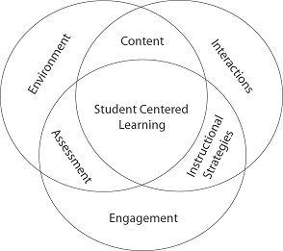
Quality, to a great extent, is Contingent upon SCL, Monitoring, Assessment-Feedback Regime

Slide 41
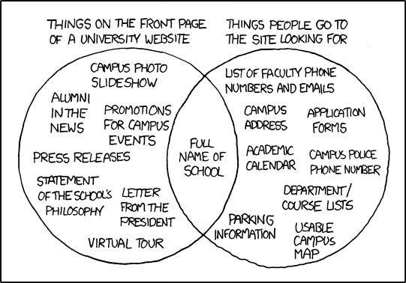
Divergences

Slide 42
Questions
-Is old–style teaching dead? Is lecturer no more the centre of the
entire paradigm?
-Is IT dictating the changes , or is it the market/economy?

Slide 43
Various References: Student Centred Learning
European Students Union Student Centred Learning Toolkit (2012):
www.esu-online.org/resources/6068/Student-Centred-Learning-Toolkit/
ESU (2015), Overview of Student-Centred Learning in Higher Education in Europe
www.esu-online.org/news/article/6068/Overview-on-Student-Centred-Learning-in-Higher-Education-in-Europe/
Higher Education Academy national surveys:
United Kingdom Engagement Survey (UKES)
National Students Survey (NSS)
Postgraduate Taught Experience Survey (PTES)
Postgraduate Research Experience Survey (PRES)
www.heacademy.ac.uk/research/surveys/united-kingdom-engagement-survey-ukes
BSU, Strategy Document (with Graduate Attributes)
www.bathspa.ac.uk/about-us/our-vision-values-history-and-people
Healey. M. et al., (2014), Engagement through Partnership: students as partners in learning and teaching in higher education
www.heacademy.ac.uk/engagement-through-partnership-students-partners-learning-and-teaching-higher-education
Saskia, J.M. et al., (2008), Incorporating Student-Centred Learning in Innovation and Entrepreneurship Education, European Journal of Education, 43 (4), 513-527.

Slide 45
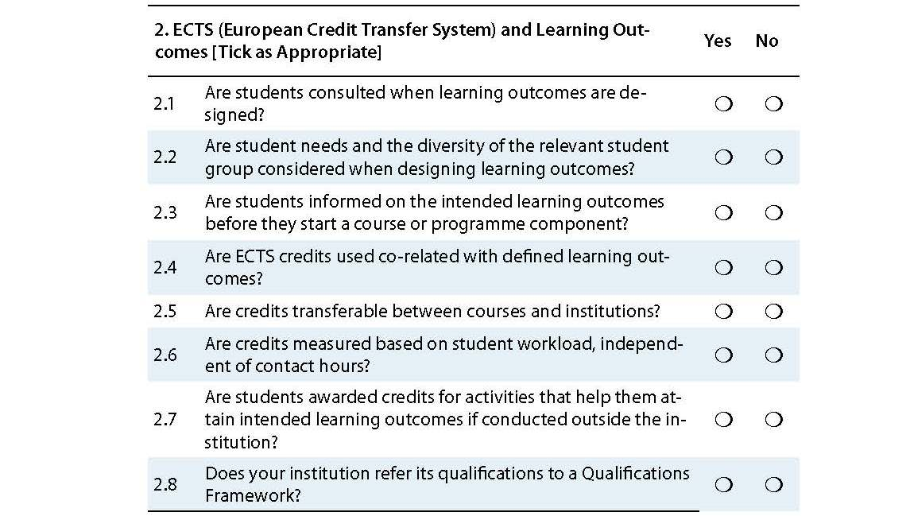

Slide 46
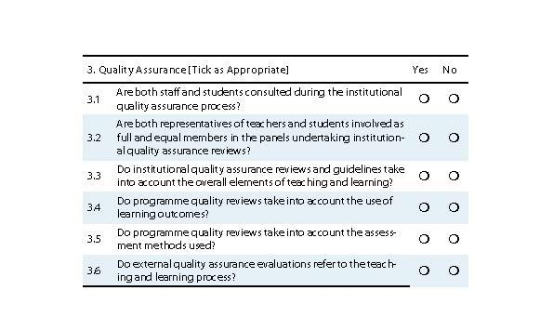

Slide 47
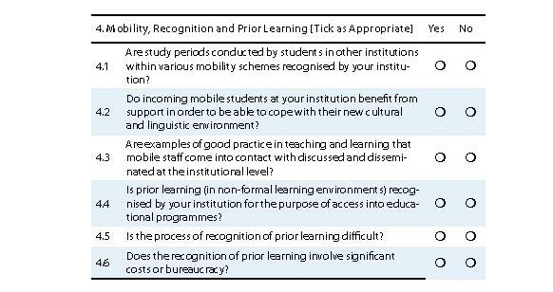

Slide 48
An Overview
https://www.youtube.com/watch?v=5CaLRiDee0E

Slide 49
Group Discussion Points
1-Is there a need for a continent/world-wide Quality Code?
2-Is the UK Quality Code too bureaucratic and complex?
3-Can we universalise student-centered learning?
4-Who is the most focal point from amongst the Students, Academics, HE managers, Market and the Community?

Slide 50
Thank You

