Slide 1
SUMMER ACADEMY UNIVERSITY KOBLENZ-LANDAU: ‘Course Development’
Dr. Sarah Hackett, Bath Spa University, UK

Slide 2
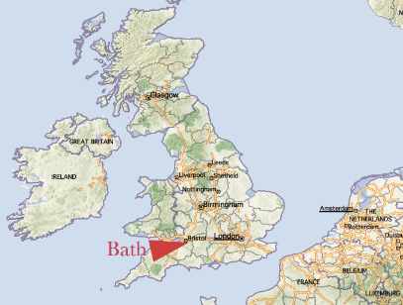

Slide 3
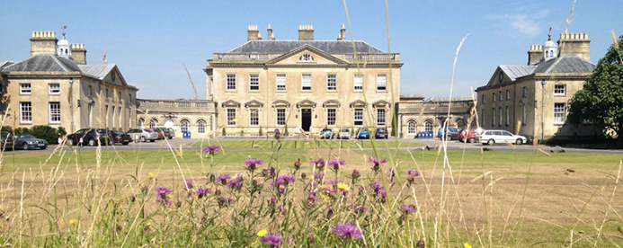
Newton Park Campus, Bath Spa University, UK
https://www.youtube.com/watch?v=UXp8ZijJ5t8

Slide 4
A few initial ideas:
‘The challenge is to present a subject to a new cohort of learners so that they will be excited and engaged by the field…
…this involves the writing of a study programme with well-articulated learning outcomes so that it can be verified to meet national and international standards, and to be a high quality learning experience for students…
Higher Education Institutions (HEIs) have the autonomy and responsibility for defining their own objectives and deriving from them coherent and clear graduate attributes. Study programmes are designed and provided by establishing associated learning outcomes which should be in line with the mission statement and profile of the HEI including its regional context.’
Source: Aligning and Checking the Alignment of a Higher Education Study Programme’s Learning Outcomes with a National Qualifications Framework: A Guideline for a Guideline (2014)

Slide 5
Principles to consider when designing a programme Fry, Ketteridge & Marshall (2003):
‘Begin where the students are … match course content to knowledge and skills of the intake … students need to be pushed and stretched but the starting point needs to reflect their current level of understanding
Make skills development integral to the curriculum. Do not assume that skills already exist. Make space for skills to be acquired in a risk-free environment
Pay attention to learning processes and not simply content or products. Design in the steps that students need
Demonstrate valuing of different cultures by building on students’ own experiences wherever possible. Knowledge and values cannot be taken for granted as higher education becomes more internationalised. Be on the lookout for cultural assumptions reflected in the curriculum and allow alternative ‘voices’ to be heard.
Avoid content and assessment overload which is liable to produce a surface approach to learning’

Slide 6
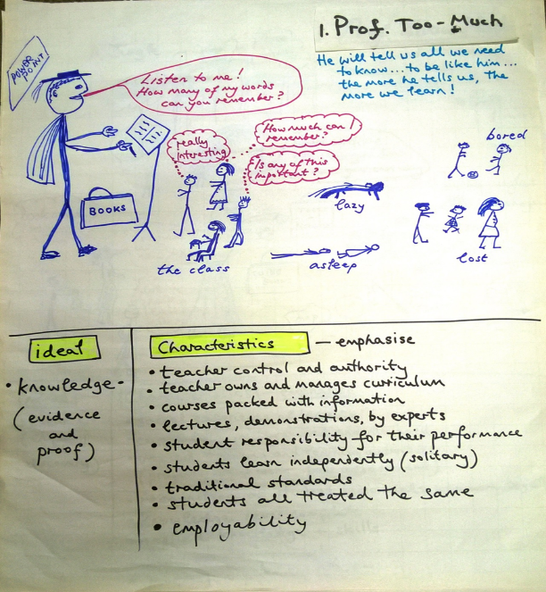
Prof. Too-Much

Slide 7
Issues to consider before/during course development:
‘Establish the desired qualification (e.g. BA), and any regulatory or professional context;
Suggest entry requirements, and intended learning outcomes for the programme and for each module;
Propose the assessment of the intended learning outcomes at both programme and module level;
Propose the optimum teaching and learning environment, including staff and the mode of provision.’
Source: Aligning and Checking the Alignment of a Higher Education Study Programme’s Learning Outcomes with a National Qualifications Framework: A Guideline for a Guideline (2014)

Slide 8
Further issues to consider before/during course development:
Will there be the managerial and administrative support needed?
How would key ‘external’ stakeholders … current & potential employers, professional associations, public bodies, government agencies, international organisations, media … be persuaded that this degree was vital to the public interest?
Does the programme/teaching team work together?
What is known about the prospective students? Have they been involved in discussions about the design of the programme?
Source: Aligning and Checking the Alignment of a Higher Education Study Programme’s Learning Outcomes with a National Qualifications Framework: A Guideline for a Guideline (2014)

Slide 9
Some key points:
‘Successful learning and teaching depend on curricula that are transparent and effective in terms of goals, learning activities and assessment of learning outcomes…’
‘ …We start with the outcomes we intend students to learn, and align teaching and assessment to those outcomes…’ (Duncan D. Nulty, Griffith Institute for Higher Education, 2012)
There need to be clear aims and desired learning outcomes
The course as an entirety is far more than the subject content of the course and the modules

Slide 10
Five Key Curriculum Design Principles:
1. Alignment / interdependence
– all elements are in alignment, they are all inter-dependent, they form a system, together they send the same message
2. Strategy
– teaching (and learning) is deliberate and purposeful, therefore it is strategic and directed
– and that means, it is aligned with the rationale.
3. What’s driving the learning? … the assessment! (more on assessment later)
– Should be an integral part of your teaching strategy (it is a teaching method).
- Should be seamlessly integrated with the rationale+aim+objectives.
4. Each assessment item:
– Should map to specific objectives.
–Should have a clear purpose.
5. Validity check the assessment
- Did you assess something not specified in the aims? Why?
– Did the aims specify something you did not assess? Why?
- Do the assessments measure what they purport to?
Source: Duncan D. Nulty, Griffith Institute for Higher Education, 2012

Slide 11
The course rationale or description:
Provides reasons for the course
Captures the whole point of the course
Justifies the course
States the real world need for the course (the value this course has for society)
Is the single most important aspect; and
informs your choices regarding the design and delivery of the course
Source: Duncan D. Nulty, Griffith Institute for Higher Education, 2012

Slide 12
The course rationale or description – an example: Muslim Migration & Islam in Europe in Historical Perspective:
HY6029-20/SR6029-20 is an optional module for students interested in the study of Muslims and Islam in Europe in historical perspective. It addresses the historical foundations of Western Europe’s post-1945 Muslim ethnic minority communities. It touches upon significant themes and events such as the relationship between the German States and Ottoman Turkish expansion during the 16th and 17th centuries, Muslim soldiers who served in the Prussian cavalry during the mid-18th century, Muslim seamen in Britain in the second half of the 19th century and North African labour migration to France in the first half of the 20th century. Whilst tackling some of the key discussions and incidents that have dominated academic and political discourse regarding Muslims in post-war Europe, including levels of integration, education, the building of mosques, terrorism, the French headscarf affair, the Danish cartoon scandal and the Rushdie Affair, this module enables students to situate recent and on-going debates within a historical context. It will draw upon a wide range of both primary and secondary sources, including newspaper articles, oral history interviews and official reports. Overall, the module allows students to engage with a wide range of material, as well as political, social and religious history.

Slide 13
Aims and Desired Learning Outcomes:
Aims are not the same as desired learning outcomes
Aims should relate to the combined impact of the curriculum, the pedagogy and the assessment of the various elements
Desired learning outcomes need to be student oriented, and should point to the knowledge, skills, competencies and attitudes of those students who successfully complete the course.
So…
Aim statements are broad and encompassing (what you want to achieve)
Desired learning outcomes are specific, behavioural, student- focussed statements (what the students should achieve)
Source: Duncan D. Nulty, Griffith Institute for Higher Education, 2012

Slide 14
Learning Outcomes – some background & ideas:
‘The achievement of learning outcomes is central to the contemporary quality approach; teaching and the whole study environment must be student-centred, which means that student needs and students’ learning have to be the point of reference for every quality standard.
The use of the learning outcomes enables clear distinctions to be made around a study programme’s qualification, e.g. Bachelor/Master, or a study programme’s orientation, e.g. vocational or academic.
The establishment of learning outcomes for a study programme can assist in making international comparisons between programmes.’
Source: Aligning and Checking the Alignment of a Higher Education Study Programme’s Learning Outcomes with a National Qualifications Framework: A Guideline for a Guideline (2014)

Slide 15
Aims – an example: Muslim Migration & Islam in Europe in Historical Perspective
The syllabus is divided into two halves. The first half addresses Islam as a religion, and the history of both Islam in Europe, and of the wider interaction between Europe and the Muslim world. The second half focuses on Muslims in post-1945 Europe and has two key aims. Firstly, it adopts a country-by-country case study approach and introduces students to key topics and debates in a range of European countries. It covers countries that are often at the centre of academic debates including Britain, France and Germany, but also those that feature far less in the English-language scholarly literature, such as Italy and Spain. Secondly, it allows students to engage with some of the key debates and discourse regarding Muslims in Europe today, including the role of women, the integration of the younger generations, and Islamophobia. Overall, this module gives students the tools needed to study and examine Islam and Muslims in Europe in historical perspective.

Slide 16
Desired Learning Outcomes - an example: Muslim Migration & Islam in Europe in Historical Perspective
1) Students will be encouraged to reflect critically on the nature of History as a discipline, and on Muslim communities and Islam in Europe in historical perspective (1/2/3);
2) To appreciate the historical impact of certain trends, themes and ideas on the perception and experiences of Europe’s post-1945 Muslim ethnic minority communities (1/2/3);
3) To acquire an understanding of the historical development of Islam and Muslim communities in Europe (1/2/3);
4) How to interpret political, social and religious history and events throughout the period; (1/2/3);
5) They will address questions as to how to find, interpret and evaluate different kinds of sources and data relevant to the study of the period and use a range of historical sources selectively and purposefully in order to construct sound historical arguments about the nature of the culture, politics and religion in this period (1/2/3);
6) Through this module students will develop more deeply their IT and research skills that are relevant to the discipline of history and to appreciate how these skills can be used across disciplines as life skills (1/2/3).

Slide 17
Desired Learning Outcomes - an example - continued: Muslim Migration & Islam in Europe in Historical Perspective
Employability skills are embedded in this module and will give students the opportunity to gain the following skills to equip them for the workplace:
• Written and interpersonal communication
• Oral presentation
• Team work
• Planning and organizing
• Problem solving
• Initiative
• Adaptability
• Numeracy
• Computer literacy (1/2/3)

Slide 18
Learning Environment:
‘Learning is encouraged through participation in a wide variety of activities, for example lectures, seminars, workshops and ####. Each module has ## hours formal contact per week, but you should allow yourself an additional ## hours each week for private study/student-centred learning.’ Bath Spa University’s position on the teaching and learning environment
Other key aspects: work experience and placement opportunities, added value, quality assurance (which Iftikhar will talk about tomorrow), external examiners; assessment (which I will go into in some detail in the next session

Slide 19
A module descriptor (the template):

Slide 20
A module descriptor (an example):

Slide 22
Further Reading:
Biggs, J & Tang, C. (2007) Teaching for Quality Learning at University. (3rd ed.)
Clarke, J. (1995) Suggestions for effective university teaching
Fry, Ketteridge & Marshall, (2003) A Handbook for Teaching and Learning in Higher Education. Enhancing Academic Practice (2nd ed.)
Light, G. & Cox, R. (2001) Learning and Teaching in Higher Education: the Reflective Professional
Toohey, S. (1999) Designing Courses for Higher Education.
Turner, D. (2002) Designing and Delivering Modules. Oxford Centre of Staff and Learning Development.

