Slide 1
SUMMER ACADEMY UNIVERSITY KOBLENZ-LANDAU: ‘Assessment Procedures’
Dr. Sarah Hackett, Bath Spa University, UK

Slide 2
The Role of Assessment in Higher Education:
It assures students and many other stakeholders about the quality and standards of courses and awards;
It helps teachers and students to focus on teaching and learning activities that are designed to enable students to develop the kind of knowledge, abilities and professional competences that will enable them to demonstrate their attainment of the key goals and learning outcomes of a course;
It enables teachers to chart the progress of students’ learning during a course, providing feedback to students on how they can improve their work, and enabling staff to adapt the content, pace and pattern of their teaching activities in the light of students’ progress
Source: Bath Spa University Assessment Framework

Slide 3
The Role of Assessment in Higher Education – continued:
It is now commonplace to think of student assessment as being not only of learning (the measurement of performance and achievement) but for learning (the guiding and supporting of students to help them enhance and improve their future work)
Most students spend most of their self-directed study time on assessment tasks, so we can say that Assessment is a vital learning process
Assessment is thus often referred to as the ‘driving force’ of student learning in higher education: students want and need to do well, and they look at the assessment system as the means by which their achievements are measured and recognised both within the university and in wider world.
Source: Bath Spa University Assessment Framework

Slide 4
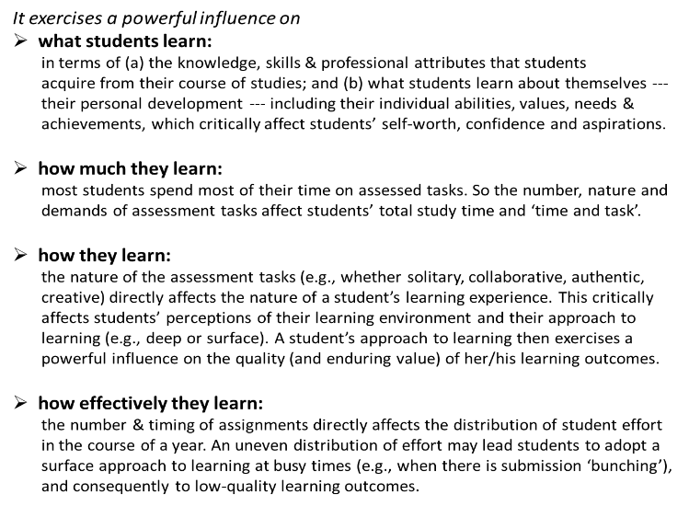
Importance of Assessment to Student Learning:

Slide 5
Propositions for Assessment Reform:
Assessment is most effective when …
assessment is used to engage students in learning that is productive
feedback is used to actively improve student learning
students and teachers become responsible partners in learning and assessment
students are inducted into the assessment practices and cultures of higher education
assessment for learning is placed at the centre of subject and programme design
assessment for learning is a focus for staff and institutional development
assessment provides inclusive and trustworthy representation of students’ achievement
Adapted from Boud, D. (2010), Assessment 2020. Australian Learning and Teaching Council.

Slide 6
10 Guidelines for Assessments:
1. All assessments should be valid, reliable and fair.
Some assessment tasks are of limited validity, not actually testing what they claim to be.
2. Assessments should test attainment of Intended Learning Outcomes.
Teaching and learning activities should provide students with opportunities to develop their knowledge and abilities in order to undertake the assessed work. This is called ‘constructive alignment’ (John Biggs).
3. Assessments should develop students’ ability to manage their own learning.
This means that students will need to develop understanding of how to measure and address their own learning needs and achievements (meta-cognition). Enabling students to become autonomous should not be confused with solitary learning.
4. Assessments should engage students and reward high-quality learning activities/outputs.
Tutor feedback should measure/grade performance (against explicit criteria) and provide practical advice on how to improve.

Slide 7
5. Formative assignments (pre-assessment exercises) may often be small scale & low stakes.
They can be embedded into normal learning and teaching activities. Tutors and peers can provide developmental feedback throughout a course. Formative exercises do not need even to be ‘marked’ or ‘graded’.
6. Each kind of assessed task should have its own assessment criteria.
For example, we would expect the assessment criteria for essays, group fieldwork projects, seminar management/presentations, knowledge tests, websites, and portfolio work to be distinctive, reflecting the particular nature of the learning outputs to be tested.
7. The processes of assessment may involve elements of self-reflection, peer-review & assessment, tutor criticism, assignment revision, external professional observation, etc.
This should not be confused with marking or grading. Normally, marking is the responsibility of the teacher, but all students can often be involved in the processes of ‘assessment’. Ensuring that assessment processes are transparent and participatory will help students to understand goals and standards, and to develop their abilities to manage their own learning. Where the marking/grading of students’ work involves other students/parties, additional attention should be paid to ensure the integrity and accuracy of the marking processes and outcomes.

Slide 8
8. The volume, variety and timing of assignments across a degree should be managed to help students plan their studies and use feedback to develop abilities.
Too many assignments may encourage a surface approach to learning; too few may lead to inadequate effort/time on task. Too much variety may reduce students’ ability to realise improvements; lack of variety may fail to engage and capture the range of students’ abilities and achievements. How tasks are related (when and in what order they are undertaken) will affect the utility of feedback.
9. Tutors must keep an appropriate summary account (online or on paper) of the assessment feedback (as well as the marks) provided on all summative work.
This is good professional practice. It can help teachers and teaching teams to reflect upon and monitor the impact and effectiveness of their teaching, and adapt their teaching plans in light of student learning.
10. Students should be well informed about all aspects of their assessments, inducted into the assessment processes and cultures of their fields of study, and engaged with staff in the continuous process of looking for ways in which assessment processes can be improved.
Source: Bath Spa University Assessment Framework

Slide 9
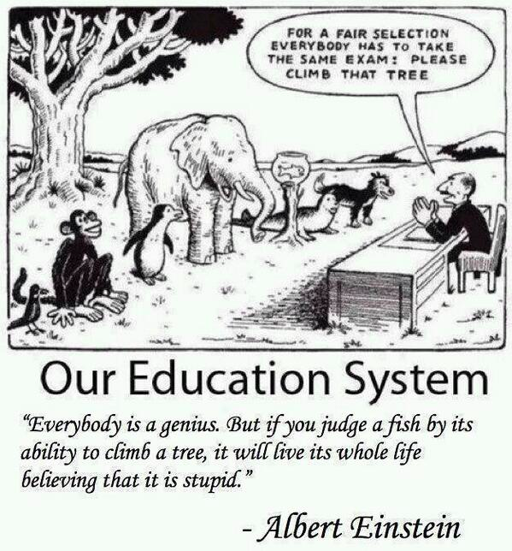

Slide 10
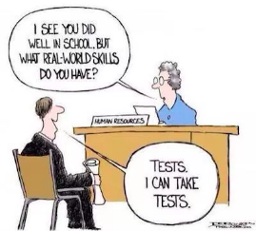
BSU Graduate Attributes:
Vision:
To be a leading university in creativity, culture and enterprise. Through inspirational teaching and research, we transform students’ lives. Based in a World Heritage city and connected to a network of international partners, Bath Spa University will ensure that its graduates are socially engaged global citizens.
Our Graduates will be:
Employable: equipped with the skills to flourish in the global workplace, able to work in, and lead, teams
Able to understand and manage complexity, diversity and change
Creative: able to innovate and solve problems working across disciplines as professional/artistic practitioners
Digitally literate: able to work at the interface of creativity and technology
Internationally networked: studying abroad for part of their programme, or alongside students from overseas
Creative thinkers, doers and makers
Critical thinkers: able to express their ideas in written and oral form, and possessing information literacy
Ethically aware: prepared for citizenship in local, national and global contexts

Slide 11
Tutor Perspectives on Assessment:
Many students will only do the summative assignments (not the courses), and generally don’t work hard enough.
Students are often strategic: they do the work that counts, and assume that we too are rational and strategic in assessing the things that are most important.
The summative assignments can be passed without engagement with and understanding of the whole course.
Tutors can set summative assignments that test knowledge and abilities across the whole course.
Many students aren’t interested in feedback (only grades and marks).
In general, this is only true where the feedback is of little or no developmental use or it comes too late for future assignments, so it does not ‘feed forward’ into future work.
Many students don’t like new or unfamiliar forms of assessment.
This may be true where new tasks are introduced without careful explanation, and where students do not have good opportunities to practise the tasks before summative assessments.
We don’t have time to learn about new ways of doing things, especially with new technologies.
Efficiency (time-saving for tutors) and effectiveness (to support student learning) can be harmonised. There are some excellent technologies that take less than hour to learn.

Slide 12
Student Perspectives on Assessment:
We are unclear about goals and standards. This can be addressed through many kind of discussions and practical exercises, in and out of class.
We are often baffled by the meaning of some terms (such as plagiarism, creativity, analytical ability) and by the use of ‘assessment criteria’. Terms and criteria should available to and discussed with students before they undertake assessments, and all assignments marked clearly against explicit criteria for that assignment.
We don’t get enough practical advice about how to improve our work. Assessment feedback is often largely focussed on providing students with a measure of their performance. To support learning, feedback also needs to be developmental; showing students how they can improve in future work.
We are very sensitive to any signs/evidence of marker variation. Where goals, standards and assessment criteria are unclear or are unobserved by all members of a teaching team, students will seek alternative explanations for the marks they see awarded.
We don’t get feedback promptly, and then it is of little use. After submitting their work, students are often anxious about when they will hear about their performance. This can be reduced greatly by setting a ‘first return of marks & feedback’ date alongside the due-date for the assignment.
We can’t read the tutor’s handwriting.
This is still a serious and quite widespread problem, easily rectified by typing or marking online. We must also ensure that students with visual impairments are treated fairly.

Slide 13
Quick Guide to Improving Assessment:
Work WITH students to review & align all aspects of assessment in a programme.
Put assessment at the heart of pedagogical practice (learn to love it & make it loveable)
Increase discussion and understanding of all goals, standards & assessment criteria
Involve students as active and key participants in assessment processes
Increase ‘formative’ exercises and all forms of developmental feedback
Use faster, and forward-looking ‘feedback’
Use simple technologies (e.g., Google, Jing, podcasts, screencasts, etc.)
Develop processes of peer review/assessment (tutor marking)
Maybe reduce summative tasks to those that really measure what’s most important
Ensure key assessments develop students’ abilities to manage their own learning
Use ‘authentic assessment’ (real-world assignments) in programmes

Slide 14
In the UK: the National Student Survey (NSS)
The NSS asks students to rate their responses to 5 statements about their assessment experiences:
- The criteria used in marking have been clear in advance.
- Assessment arrangements and marking have been fair.
- Feedback on my work has been prompt.
- I have received detailed comments on my work.
Feedback on my work has helped me to clarify things I did not understand
But this is just a starting point! For assessment is no longer considered simply as something that we do to or for our students, but something we need also to do with them.
Many other important questions can be asked about assessments. For example:
- Are the assignments inspiring and important to all students; encouraging them to attain their ‘personal best’?
- Do the assignments encourage students to be creative, enterprising and culturally aware?
- Will the completion and products of the assignments be of enduring value to students in the years ahead?
- How far do the assignments enable students to build upon their distinctive individual talents and interests?

Slide 15
Designing Assessment Tasks:
Subtle differences in the design, preparation and timing of assignments can have a great impact on how students tackle them and on the quality of the work produced.
Although some traditional types of assessment (e.g., essays) are still widely used, many assessment tasks are not easily categorized as they represent a blend of activities:
- Students need to develop and showcase their expertise as professionals who are ready to work in many kinds of employment.
- Authentic assessments help students to contextualise and apply their learning, to see how real-life conditions or situations, in all their unpredictability, ambiguity and complexity, affect their theoretical knowledge.
- Simulated real-world assignments help students help students draw together their knowledge and abilities to engage productively and solve problems. They become truly authentic assessments when the assignment requires students to use their learning to address a real and current challenge.

Slide 16
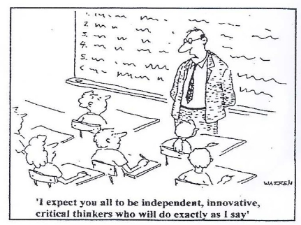
Types of assessment:
Individual or group-based presentations
Dissertation and major projects
Essays
Examinations
Exhibitions
Research Projects
Studio work
Performances
Reviews
Negotiated assignments

Slide 17
References on the Assessment of Students:
Boud, D. et al. (2010), Assessment 2020: Seven propositions for assessment reform in higher education. Australian Learning and Teaching Council.
Evans, C. ( 2013), Making Sense of Assessment Feedback in Higher Education, Review of Educational Research, 83 (1), 70–120.
Falchikov, N. (2005), Improving Assessment through Student Involvement. Routledge.
Gibbs. G. (2005), Conditions under which assessment supports student learning’, Learning and Teaching in Higher Education 1, 3-31.
Nicol, D. (2011), Developing students' ability to construct feedback. QAA Scotland, Enhancement Themes.
Nicol, D. et al (2014), Rethinking feedback practices in higher education: a peer review perspective, Assessment & Evaluation in Higher Education, 39 (1) , 102-122.
Price, M.et al. (2010), Feedback: all that effort, but what is the effect? Assessment & Evaluation in Higher Education, 35 (3), 277–289
Price, M. et al. (2011), If I was going there I wouldn’t start from here: a critical commentary on current assessment practice, Assessment & Evaluation in Higher Education, 36 (4), 479–492.
For a tool designed ‘to help universities to review current policy and practice in assessment and feedback, with a view to radically rethinking the institution’s assessment strategy’, see A Marked Improvement: Transforming Assessment in Higher Education (HEA, 2012). www.heacademy.ac.uk/resource/marked-improvement
For video and online resources on ‘Effective Assessment in a Digital Age’, see JISC site: www.jisc.ac.uk/assessresource
For UK-based projects designed to improve assessment and feedback practices:
TESTA (Transforming the Experience of Students through Assessment) www.testa.ac.uk
The REAP site (Re-engineering Assessment Practices) on the need for students to learn through ‘Peer Review’: www.reap.ac.uk/PEER.aspx

