Slide 1
Introduction to Quality Management
Isabel Cavaco
Workshop “Quality Assurance in Higher Education Institutions”
University of Algarve
February 20, 2012

Slide 2
Contents
Introduction – the meaning of “Quality”
Quality Management Systems
  Quality Policy and Leadership
  The Process Approach
  Quality System Documentation
  Measuring Effectiveness and Efficiency
  Continual Improvement
Standards for Quality Management Systems
Discussion: quality systems in higher education

Slide 3
1
Introduction
  The concept of “Quality”

Slide 4

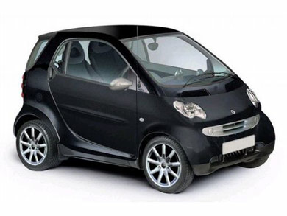
The Meaning of “Quality”
In common language, it means excelency, something very good
What is good for one case is not necessarily good for another.
  Cars are a good example...

Slide 5
The meaning of “Quality”
Inputs
Process
Outputs
Notes:
Any product of service is created according to processes, i. e., a set of activities where people convert a mix of inputs into another mix of outputs. Take, as an example, a fast-food company. It converts raw materials into lunches and dinners, in attractive packs, ready to eat. The results of this process are dinner or lunch, and convenience. Consequences include the impact of results both on the user and society. The possibility of eating on a train is a positive consequence of packed food for travellers. A potential negative consequence for society may be the pollution caused by the empty packages thrown in the highways.

Slide 6
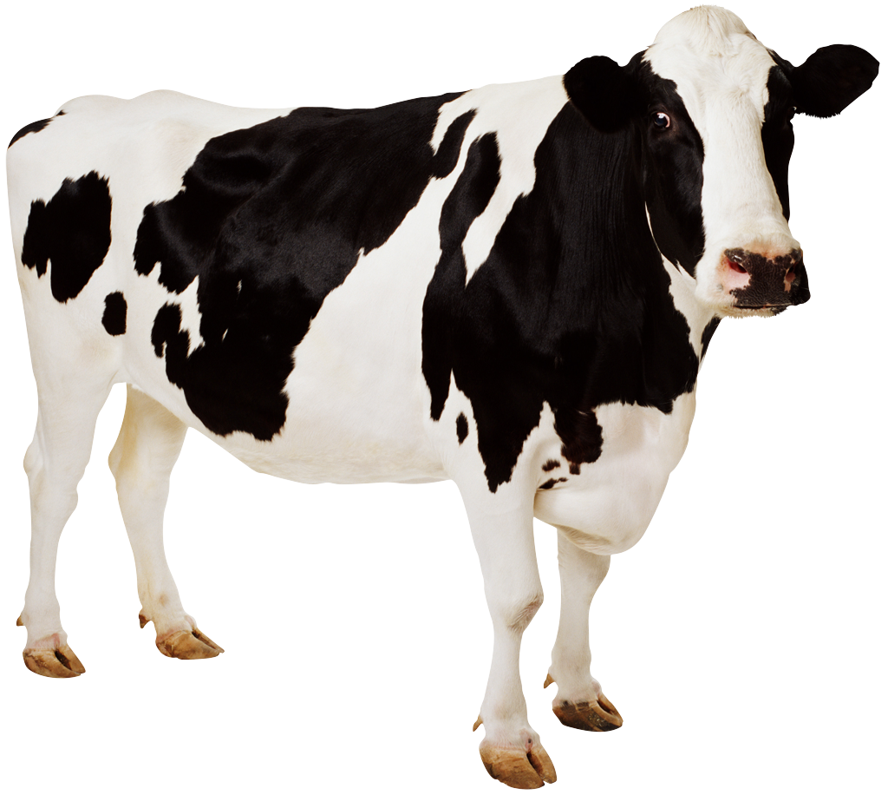

The meaning of “Quality”
Inputs
Process
Outputs
ready to eat lunchs
raw materials
Notes:
Any product of service is created according to processes, i. e., a set of activities where people convert a mix of inputs into another mix of outputs. Take, as an example, a fast-food company. It converts raw materials into lunches and dinners, in attractive packs, ready to eat. The results of this process are dinner or lunch, and convenience. Consequences include the impact of results both on the user and society. The possibility of eating on a train is a positive consequence of packed food for travellers. A potential negative consequence for society may be the pollution caused by the empty packages thrown in the highways. a mix of inputs into another mix of outputs

Slide 7
The meaning of “Quality”
Can be seen from several perspectives:
  The result
  The process
  The consequences

Slide 8
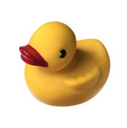
The meaning of “Quality”
Based on the Product
  Differences in quality correspond to differences in the amount of one ingredient or desired attribute
  Price is not the most important factor
  Consumers’ needs have a role in the definition of quality

Slide 9
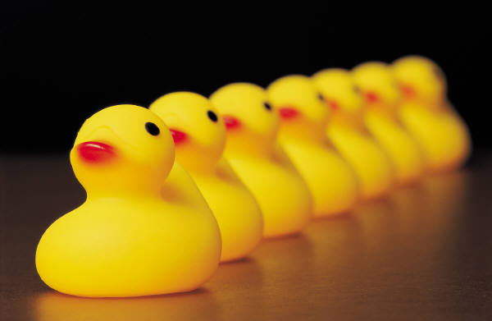
The meaning of “Quality”
Based on the Production
    Quality is conformity to specific requirements
    Process variability is a menace to quality
    Statistic methods are applied to measure and control variability in conception, production and final product
    Does not lead directly to consumer satisfaction
Crosby, 1979

Slide 10

The meaning of “Quality”
Based on the Value
  Quality is the degree of excellence at an acceptable price, or the control of variability at an acceptable price
  Relation quality/cost is very complex
  “value for money”
  Feigenbaum (1951), Abbott (1995)

Slide 11
The meaning of “Quality”
Based on the User
  Quality is the capacity of fulfilling the needs of a specific user.
  Satisfying or exceeding consumers’ expectations
  Difficult to translate into product specifications…
  Juran (1974), Groonroos,(1983), Parasuraman (1985)

Slide 12


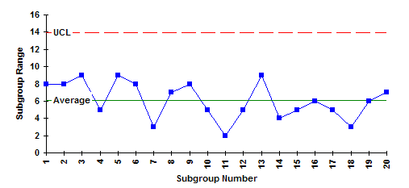
The development of Quality
1200-1799
Guilds in
Medieval
Europe
1800-1899
Industrial
Revolution;
mass production
1900-1940
Process
Orientation
1941-1945
Quality in
WW2
1946-today
Total Quality
Management
Product
Inspection
Product
Inspection
Statistical
Quality Control
Sampling
Inspection
Statistical
Quality Control
Shewart
Deming
Juran
Product
Inspection
Notes:
medieval ages:
guilds: an association of craftsmen in a particular trade.
Skilled artisans
The quality of a product came from the fame of the artisan.
1 person/group made a product from start to finish.
Industrial revolution: 1750-1850
Mass production.
Teams do different parts of the production, and do not necessarily finish it.
VARIABLE QUALITY OF OUTPUT!
Some companies (ex: Ford) created quality management departments to control the overal quality of the products, by product inspection.
Industrial Age
Statistical quality control (sampling) began with Juran and Deming

Slide 13

The meaning of “Quality”
Quality
Product
Production
Value
User
Consequences
QUALITY POLICY
Notes:
Before setting up a quality system, you must define what you want to achieve – what is “quality” for you, for your institution?
Most probably, you will need to consider all these points of view.
For a higher education institution, what is the “product”?
graduated students
scientific knowledge
To define quality in the product, we must know who are the clients, and what do they expect.
Who are the clients?
- the government
society
students
student families
employers
What do they expect? You must find out...
output of Nobel Prizes?
easily employable graduates?
applied knowledge. readily usable in new industries/business?
fundamental knowledge, used for long-term development?
prestige? (governments?) International recognition/respect?
Quality from the point of view of the “production”. You must define what the processe(s) are, and then how they will be optimized.
Teaching students – you will need the best teaching staff, at the lowest cost – better to hire dedicated staff than to invite from other institutions. You need to run classrooms, labs, installations. You must define exactly what you expect your students to learn, and not just leave it for each professor to decide – Bologna process.
Quality from the point of view of “value for money”
is always important, but certainly is the least important in higher education...
Quality from the point of view of exceeding constumer’s expectations
we must define who are the costumers, and which are their expectations.
Quality feom the point of view of the consequences:
a unversity has a high influence on the society, on the development of the city where it is located, on promoting exchange of ideas, etc

Slide 14
2
Quality Management Systems
  General Guidelines

Slide 15
Fundamental definition
Quality Management System
Quality Assurance System
Quality System
is the set of procedures and responsibilities that an organization puts in force to attain its definition of Quality.

Slide 16
Quality Management Principles
Quality Management Principles
  Quality Policy and Leadership
  The Process Approach
  Quality System Documentation
  Measuring Effectiveness and Efficiency
  Continual Improvement

Slide 17
Quality Management Principles
Quality Management Principles
  Quality Policy and Leadership

Slide 18
1. Quality Policy and Leadership
A Quality System is a tool to reach objectives
The objectives of the organization must be clearly defined in its
Quality Policy Statement

Slide 19
Quality Policy
The Quality Policy Statement sets a clear goal for the organization.
It may include:
  The mission
  The vision
  The objectives
Notes:
Having an objective for the staff and managers to work toward provides an incentive to improve efficiency, maintaining quality and improving productivity.

Slide 20
Quality Policy
The Quality Policy Statement may include:
  The mission
  The vision
  The objectives
Notes:
Having an objective for the staff and managers to work toward provides an incentive to improve efficiency, maintaining quality and improving productivity.

Slide 21
1. Quality Policy
Costumer Focus
  In a QS it is essential to identify who are the costumers
  Understand current and future costumer needs
  Meet costumer requirements
  Strive to exceed costumer expectations

Slide 22
Quality Objectives
The Quality Policy provides the framework to establish the Quality Objectives
The Quality Objectives must be consistent with the Quality Policy and the commitment to continual improvement, and their achievement needs to be measurable
Notes:
Having an objective for the staff and managers to work toward provides an incentive to improve efficiency, maintaining quality and imporving productivity.

Slide 23
Quality Policy – example 1a
Royal Roads University Quality Assurance Policy
Royal Roads University is for people who wish to advance in the workplace. Our students share a passion for learning, a curiosity about the world, and a desire to contribute meaningfully to their organizations and communities. RRU was created to meet these needs by delivering applied and professional programs, primarily at the graduate level, that anticipate and respond to the changing world and global economy.
We are a recognized leader in providing accessible and relevant education, targeted to labour market needs, and delivered through innovative, pioneering technology. We are committed to the highest level of quality, teaching excellence, and applied research that pursues solutions to real-world problems.
(www.royalroads.ca)

Slide 24
Quality Policy – example 1b
Royal Roads University Quality Objectives
To effectively meet this mandate the University:
- Operates with governance and policy structure that allows programs to be developed quickly in response to labour market needs;
- Uses external advisory boards to define and monitor what knowledge, skills and attitudes employees are looking for in graduates;
- Uses innovative educational technologies to support adult learning principles and to provide flexible learning options to Canadian and global learners;
- Requires learners to not only acquire relevant knowledge, but also to demonstrate the ability to perform well in workplace environments.
(www.royalroads.ca)

Slide 25
Quality Policy – example 2
Quality at the University of Helsinki means expedient activity and high-quality results. The cornerstones of the quality policy at the University of Helsinki are:
through quality work the University of Helsinki reinforces its position as one of the best research universities in Europe
each University community member, from teachers and researchers to other staff members and students, is responsible for the quality of the University in their activities
- the University quality assurance system supports the activity and development of activity of each member of the University community, their unit and the whole University community
(www.helsinki.fi)

Slide 26
Quality Policy – example 3
Anna University strives to be recognised as a world class center of learning in engineering, technology and applied sciences. To achieve this, Anna University is committed to
Raising the quality of education and maintaining the University as an effective human resource development institution under all changing conditions
Contributing to the growth of technical education and upholding the highest ethical and professional standards
Serving society to lead to its enrichment and advancement
Discharging duties and obligations to the students and staff efficiently
- Improving the effectiveness of the Quality Management System continually
(www.annauniv.edu)

Slide 27
Quality Policy – example 4
The European Master in Quality in Analytical Laboratories (EMQAL) is a Joint Master course developed by the consortium of Universities. These are the University of Algarve, University of Barcelona, University of Bergen, University of Cadiz, Gdansk University of Technology and Central South University. The Universities in the Consortium have agreed on the following Quality Policy regarding EMQAL:
The mission of EMQAL is the capacity building and training of students to form highly competent professionals for implementing and managing Quality Systems in analytical laboratories. These can be in diverse fields of analysis according to European standards and policies. EMQAL promotes European cooperation and research leading to higher quality standards in laboratory accreditation.
The vision of EMQAL is to be a world leader and reference in Higher Education for analytical laboratory professionals. EMQAL aspires to be a model of successful European cooperation promoting international harmonization of analytical procedures.
(www.cursos.ualg.pt/emqal)

Slide 28
Quality Policy
The Quality Policy Statement:
  establishes clear objectives for the institution
  motivates internal staff towards common objectives
  promotes the external image of the institution

Slide 29
1. Quality Policy and Leadership
Leadership
  Leaders establish unity of purpose and direction
  Leaders can assure that people become fully involved in achieving the organization’s objectives
  The Quality Policy must be defined by the top management / highest hierarchy in the institution
  A strong leadership is essential for the success of a QS!

Slide 30
Role of top management - 1
To establish and maintain the Quality Policy and Quality Objectives;
To promote the Quality Policy and Quality Objectives;
To ensure focus on costumer requirements
To ensure appropriate processes are implemented
Notes:
Having an objective for the staff and managers to work toward provides an incentive to improve efficiency, maintaining quality and imporving productivity.

Slide 31
Role of top management - 2
To ensure that an effective and efficient Quality System is established
To ensure the availability of necessary resources
To review the Quality System periodically
To decide on actions regarding the Quality Policy and Quality Objectives

Slide 32
Quality Management Principles
Quality Management Principles
  Quality Policy and Leadership
  The Process Approach

Slide 33
The Process Approach
Process: a collection of activities / tasks that produce outputs (services or products) from inputs
Inputs
Process
Outputs

Slide 34
The Process Approach
Example: student registration
Student data
Registration
Student number in database;
List of disciplines

Slide 35
The Process Approach
Example: teaching
“raw” Student;
student number;
timetable for classes
Discipline A
Prepared student; grade in database

Slide 36
The Process Approach
Example: Preparation of classes timetables
List of disciplines in faculty;
List of requirements;
List of available classrooms
Lists of students
timetable generation
Timetable for all classes in faculty

Slide 37
The Process Approach
Example: Diploma issuing
Student number
List of grades for disciplines
Diploma issuing
Final grade and Diploma

Slide 38
The Process
Approach
  Results are achieved more efficiently
System Approach to Management
    Identifying, understanding and managing interrelated processes
    costumer-supplier relationships between processes

Slide 39
Quality Management Principles
  Quality Policy and Leadership
  The process Approach
  Quality System Documentation

Slide 40
Quality System Documentation
Say what you do.
Do what you say.
Prove it.

Slide 41
Documentation
Enables communication of intent and consistency of action
The documentation in a QS has 3 functions:
  To describe the activities in the QS
  To act according to what is written
  To prove it.

Slide 42
Documentation
Hierachical structure of documentation
  Quality Manual(s)
  Quality Procedures
  Technical Procedures
  Records
Quality Manual
Quality Procedures
Records
Technical procedures

Slide 43
Documentation
Quality Manual
  describes the Quality Policy of the organization
  describes the general guidelines of the system:
    organigrams and responsibilities
    organization of documentation
    Mechanisms for continual improvement
  Must be approved by the highest hierarchy in the institution.

Slide 44
Quality Management Principles
Quality Management Principles
  Quality Policy and Leadership
  The process Approach
  Quality System Documentation
  Measuring Effectiveness and Efficiency

Slide 45
Effectiveness and Efficiency
Effectiveness
  the extent to which planned activities are realized and results achieved.
Efficiency
  relationship between the result achieved and resources used
Notes:
You can be effective and not be efficient.
And you can be very efficient but not effective...
Ex: In the teaching process, effectiveness implies getting well prepared students with high grades.
Efficiency would be doing it using the minimum resources: less time for classes, less dedicated time from lecturer, less number of classrooms...

Slide 46
Measuring effectiveness and efficiency
Continual Improvement
  Should be a permanent objective
  Improvement must be based on facts, not opinions
Factual Approach to Decision Making
  Decisions are based on the analysis of data and information
  collection of reliable data is essential!
Notes:
Measuring effectiveness and efficiency is essential for...

Slide 47
Quality Indicators
Quality indicators are numbers that measure efficiency and effectiveness
Quality indicators are calculated from objective data.
Quality Indicators are used to quantify the extent to which the Quality Objectives are met.
Quality indicators should be
  simple and as few as possible
  Complementary
  Indicate clear measurements

Slide 48
Examples of Quality Indicators
Indicator | Example
Costumer satisfaction | =(#complaints)/(#clients)
Efficiency of staff management | =(#hours of staff doing productive work)/(total # of hours)
Effectiveness of Quality Management | =(#of nonconformities detected in External Audits)/(# of conformities detected in Internal Audits)
Confidence | =(# of work requests)/year

Slide 49
Examples of Quality Indicators
In Higher education institutions?
Indicator | Example
Effectiveness of teaching
Efficiency of research activities
Efficiency of Diploma issuing
Effectiveness of student graduation

Slide 50
Examples of Quality Indicators
In Higher education institutions?
Indicator | Example
Effectiveness of teaching | = (average student grade) / (spread of student grades)
Efficiency of research activities | = (# scientific publications) / (# of researchers)
Efficiency of Diploma issuing | = average time lapse between issuing of grades and issuing of diploma
Effectiveness of graduation | = (# diplomas issued) / (# of registered students)

Slide 51
Risks of Quality Indicators...
Indicator | Example
Effectiveness of teaching | = (average student grade) / (spread of student grades)
Efficiency of research activities | = (# scientific publications) / (# of researchers)
Efficiency of Diploma issuing | = average time lapse between issuing of grades and issuing of diploma
Effectiveness graduation | = (# diplomas issued) / (# of registered students)
Problems
Grades may be inflated...
Number of publications does not reflect quality of research...
External factors (ex: change in legislation) may affect time lapse
Depends on the quality/performance of students

Slide 52
Quality Indicators
Quality Indicators
Follow “critical Points”
Antecipate Tendencies
Measure results
Quality Indicators alow
  Anticipation of tendencies
  Knowing the evolution of “critical points”
  Immediate reaction and correction
React and Correct

Slide 53
Quality Management Principles
Quality Management Principles
  Quality Policy and Leadership
  The process Approach
  Quality System Documentation
  Effectiveness and Efficiency – how to measure
  Continual Improvement

Slide 54
The cycle of continuous improvement - PDCA
Establish the objectives and processes
Do
Check
Act
Plan
Implement the processes
Take actions to continually improve process performance
Monitor and measure processes and products, and report the results

Slide 55
The cycle of continuous improvement - PDCA
A
C
A
P
D
C
A
P
D
C
P
D

Slide 56
Continual Improvement
Analysing and evaluating the existing situation to identify areas for improvement;
Establishing the objectives for improvement
Searching for possible solutions to achieve the objectives;
Evaluating these solutions and making a selection;
Implementing the selected solution
Measuring, verifying, analysing and evaluating results of the implementation to determine that the objectives have been met
Formalizing changes / or making necessary adjustments
P
D
C
A

Slide 57
Evaluation of the QS
Are the processes identified and appropriately defined?
Are responsibilities assigned?
Are the procedures implemented and maintained?
Are the processes effective in achieving the required results?

Slide 58
Evaluation of the QS
Quality Audits
Review of the Quality System
Self-Assessment

Slide 59
Quality Audits
Used to determine the extent to which the QS requirements are fulfilled
Audit findings are used to assess the effectiveness of the QS and to identify opportunities for improvement
May be:
  First-party – internal quality audit
  Second-party
  Third-party
ISO 19011

Slide 60
Review of the Quality System
Role of the top management
Regular systematic evaluations of the suitability, adequacy, effectiveness and efficiency of the QS with respect to the Quality Policy and Quality Objectives
Can include consideration of the need to adapt the Quality Policy and Objectives to changing needs.
Audit reports are used for review of the QS.

Slide 61
Self-Assessment
Comprehensive and systematic review of the organization’s activities and results referenced against the QS or a model of excellence
Can provide an overall view of the performance of the organization

Slide 62
Implementing and maintaining a QS
Processes and responsibilities
Measure effectiveness and efficiency
Prevent nonconformities and their causes
Continual Improvement
Resources
QA
Quality Policy
RQS
Statistical
Techniques
SA
Notes:
Efficiency is different than effectiveness. Effectiveness is the extent to which planned activities are realized and results achieved. Efficiency is the relationship between the result achieved and resources used.

Slide 63
3
Standards for Quality Management Systems

Slide 64
Quality Systems
The structure of a Quality System should follow a standard pattern
Standardization Organisms create Standards that define rules for many diverse activities, including how a Quality System should be organised
Notes:
There are many different ways to make a QS.

Slide 65
Quality Systems in Higher Education
International Standards
  International Organisation for Standardisation (ISO)
    ISO 9001/2008 – “Management Systems – Requirements”
    Certification – competence is not evaluated...
Notes:
Within the international standards for how to make a Quality System, the one that is more widely known is ISO 9001. It applies to all kinds of organizations: factories, services entreprises, laboratories, etc. Wherevever there is management, you can apply a quality system, and so you can apply ISO 9001.
But, for laboratories of analysis there is a much more adequate standard: ISO 17025. This applies only to labs.
Which is the difference?
It’s the same as the difference between the quality of a car and the quality of an analytical result. For the car, it is enough to be good. For a result, to be good is not enough. You must TRUST it. Confidence is critical, when you talk about analytical results. For a car, you can test its performance, and evaluate its quality. For an analytical result, you must test the performance of the lab, not of the result – the lab must be COMPETENT. And that’s much more demanding than making cars.
So 17025 has the same requirements as 9001, and more – it requires competence.
Like the wife of Ceaser, a lab must not be just competent _ it must look competent.
There is another international standard for laboratories of analysis, much more demanding even than 17025: GLP. It applies to labs that analyse the toxicity or health effect of products, before they are allowed to be comercialised.

Slide 66
Quality Systems in Higher Education
International Standards
  European Association for Quality Assurance in Higher Education (ENQA):
    “Standards and Guidelines for Quality Assurance in the European Higher Education Area”, 2007
    Accreditation – competence is evaluated.
Notes:
Within the international standards for how to make a Quality System, the one that is more widely known is ISO 9001. It applies to all kinds of organizations: factories, services entreprises, laboratories, etc. Wherevever there is management, you can apply a quality system, and so you can apply ISO 9001.
But, for laboratories of analysis there is a much more adequate standard: ISO 17025. This applies only to labs.
Which is the difference?
It’s the same as the difference between the quality of a car and the quality of an analytical result. For the car, it is enough to be good. For a result, to be good is not enough. You must TRUST it. Confidence is critical, when you talk about analytical results. For a car, you can test its performance, and evaluate its quality. For an analytical result, you must test the performance of the lab, not of the result – the lab must be COMPETENT. And that’s much more demanding than making cars.
So 17025 has the same requirements as 9001, and more – it requires competence.
Like the wife of Ceaser, a lab must not be just competent _ it must look competent.
There is another international standard for laboratories of analysis, much more demanding even than 17025: GLP. It applies to labs that analyse the toxicity or health effect of products, before they are allowed to be comercialised.

Slide 67
4
Discussion: Quality Systems in Higher Education

Slide 68
4. Discussion: Quality Systems in Higher Education
Processes and responsibilities
Measure effectiveness and efficiency
Prevent nonconformities and their causes
Continual Improvement
Resources
QA
Quality Policy
RQS
Statistical
Techniques
SA
Notes:
Efficiency is different than effectiveness. Effectiveness is the extent to which planned activities are realized and results achieved. Efficiency is the relationship between the result achieved and resources used.

Slide 69
Thank you!

