Slide 1
Companies of all types and sectors use quality as a strategic touchstone and organizing principle.

Slide 2
A kind of unified "quality-value" metric
The greatest customer demand for quality than ever before
highly competitive worldwide marketplace
advances in information technology
Quality for cosumers a fundamental measure of their total perception of the product or service as well as of the company’s delivery and maintenance network that provides and supports it.

Slide 3
Food industry Quality assurance (QA) systems
Good manufacturing practice (GMP)
HACCP
IFS
BRC
ISO
applied voluntary
ensure food quality and food safety
prevent liability claims
build and maintain trust of consumers

Slide 4
QA system covers different quality aspects
Some focus on management aspects (ISO)
others focus on technology aspects (GMP and HACCP)

Slide 5
Other quality attributes influence expectations of consumers
sensory properties
shelf-life
Reliability
convenience

Slide 6
QA system: Not only consistent product quality
different elements to determine firms’ marketing strategy
An examination regarding how different types of goods can be identified according to their quality attributes
The benefits of participating in a quality award procedure
How QA systems and their certification affect a firms’ performance
How consumers respond to quality as a differentiating product characteristic, especially for organic farming products. Their willingness to pay a price premium for it.

Slide 7
Information asymmetry and product quality
between supplier and customer,
different types of goods can be identified according to the dominant quality attributes
distinction between search or shopping and experience attributes, credence attributes
these attributes altered the perception of food products from rather uncomplicated raw commodities with easily detectable qualities to somewhat more sophisticated goods
For search goods the buyer is able to find evidence of the attributes even prior to the purchase
for experience goods the verification of the attributes’ correctness can only be exercised right after the purchase
Credence attributes are product and service characteristics that cannot be detected by the buyer under ordinary circumstances, neither before nor after the buying process.

Slide 8
Typology of goods based on Information Economics

Slide 9
Controls
“Potemkin” attributes characterized by the fact that neither the buyer nor external institutions are able to carry out controls through laboratory analyses at the end-product level. Nearly all process-oriented attributes (e.g., animal welfare, dolphin-safe tuna, fair trade, etc.)
credence attributes, fraud and mislabelling can be revealed by inspections carried out by external organizations, public authorities, or competitors

Slide 10
likelihood of detecting a firm’s falsely claiming
the amount of monitoring in the respective product category
whether the company is famous enough for newspaper reports.

Slide 11
Specific marketing investments (advertising, branding) bind manufacturers
even though high information asymmetries create strong incentives for cheating
Assuming a strict third-party monitoring and a high disclosure rate, credence goods could theoretically be treated as experience goods
Third parties supplying customers with information about credence goods result in reliable quality signals

Slide 12
The Quality Awards
1951, Japan through the establishment of the Deming Prize
Inspired by the successful development in Japan, several other countries established, at the end of the 1980s, programs to recognise quality practices taking place in organisations

Slide 13
usually based on the methodology of self-assessment
[EFQM 1996]: self-assessment is “a comprehensive, systematic and regular review of an organisation’s activities and results referenced against a model of business excellence”.
During both a quality award process and self-assessment, the organisations pass through the four phases of the improvement cycle
Plan,
Do
Study
Act

Slide 14
major benefits of participating in a quality award process
greater focus on improved work processes customers
an impact on “committed leadership”, “participation by everyone” and “management by facts”.

Slide 15
THE PROJECT
Project Identity
Importance
Cost / Financing
THE COMPANY
Institutional Framework
Organisation
THE OUTPUT
Opening of sections to traffic
Other Projects
Diffusion of experience
Notes:
Telematics (sub)systems for Kavala Bypass
traffic monitoring
incident management
weather conditions monitoring
motorists advisory
data collection
(Παρακολουθηση φωτισμου και γεωτεχνικων χαρακτηριστικων)

Slide 16
participating in the award process benefits for quality award applicants
improvement areas, which can support actual improvements, are identified
executed improvements can result in
greater customer orientation
more effective and efficient processes
better employee relations
an increased profitability of the award applicants.

Slide 17
Quality assurance systems and consumers

Slide 18
The concept of food quality
the quality of food products, in conformity with consumer requirements and acceptance, is determined by their
sensory attributes
chemical composition
physical properties,
level of microbiological and toxicological contaminants
shelf-life
packaging and labeling
Food safety has primary significance for food quality

Slide 19
the consumer is the key to defining quality
What is quality?
Many people have difficulty answering this.
A common response is, “I can’t define quality, but I know it when I see it.”
Inability to define quality does not, however, preclude interest and strong opinions regarding the concept

Slide 20
not only to demand higher levels of safety in their food
concerns about
environmental sustainability
logical use of natural resources
protection of farmers’ and animals’ health
changes in attitudes and values stimulated by a number of food scares and crises (e.g. Bovine Spongiform Encephalopathy, Foot and Mouth Disease, dioxins, pesticide residues, veterinary drugs, etc.) that have affected consumers’ confidence in food quality and food safety

Slide 21
Quality claim insufficient to ensure any advantage
Achieving competitive advantage through quality requires
an understanding of the quality requirements of the consumer
a method of measuring efforts to provide for these quality requirements, and a commitment to do both

Slide 22
effective communication for value-added markets (i.e organic food) to be successful
Consumers must be aware of the existence and meaning of products encapsulating differentiated quality characteristics
even more, they should have a favourable attitude towards them. In addition, consumers must be willing to pay an extra amount of money for such products

Slide 23
Consumers willingness to pay for organic food products
socio-demographic characteristics
perceived quality
risks
important determinants of consumer’s attitudes towards certified foods and of their willingness to pay (WTP) a premium to buy these products

Slide 24
WTP is positively influenced by
gender (man)
positive attitudes towards organic products in general.
negatively related with low family income.
the positive attitude towards organic products increases the WTP.
More specifically, consumers of organic products were willing to pay higher price premiums indicating that organic buyers believe that the organic nature of the foods makes them really attractive despite their higher prices.

Slide 25
main determinants of WTP for multiple attributes of organic rice in the Philippines
socio-demographic characteristics
risk perceptions
The high-income group was found to have a higher WTP than the middle-income group, while the WTP for risk reduction for the high-income group was lower than the one for the middle-income group.

Slide 26
organic food sector
consumers demand higher levels of safety and quality in their food
they express concerns about the environmental sustainability
the logical use of natural resources
protection of farmers’ and animals’ welfare.
factors such as socio-demographic characteristics (i.e. gender, children under the age of 18 in the household, income, education, etc), the perceived quality and risks have been found to be important determinants of consumer’s attitudes towards certified foods and of their willingness to pay a premium to buy these products

Slide 27
a quality certification is something different than the implementation of a QA system
The greatest gain from quality certification is widened market opportunities
[Although, some firms perceive the certification process as a game they can win by cheating] the principal motive for pursuing a quality certification is the certificate’s ability to open doors to customers that were previously closed, or will be closed if the quality certification is not achieved.

Slide 28
Quality labels have become a central component of modern consumer policy
However, a certification label is an example of a “Potemkin” good in itself
In contrast to this, most researchers (implicitly or explicitly) assume perfect certification
Not fully credible standards jeopardize public confidence and lead to market failure on a higher level resulting welfare loss of such mislabelling
For example, more than 15 years after the EC regulation No. 2092/91 on organic farming, a lack of trust is still one of the most important diffusion barriers . This may be ascribed to insufficient marketing for the label but it also indicates a line of detected frauds.
Certification systems mainly depend on trust. Therefore, it is necessary to improve certification and audit procedures.

Slide 29
Conclusions
QA systems can be useful to improve the production process and hence to reduce production cost
a QA system can be accepted as an important ingredient of marketing that offers producers a great opportunity to differentiate themselves in the market. A QA system can be used as a marketing tool that protects companies in an environment of distrust and as a differentiating strategy that will add value to their products and justify higher prices for their products in the market.

Slide 30
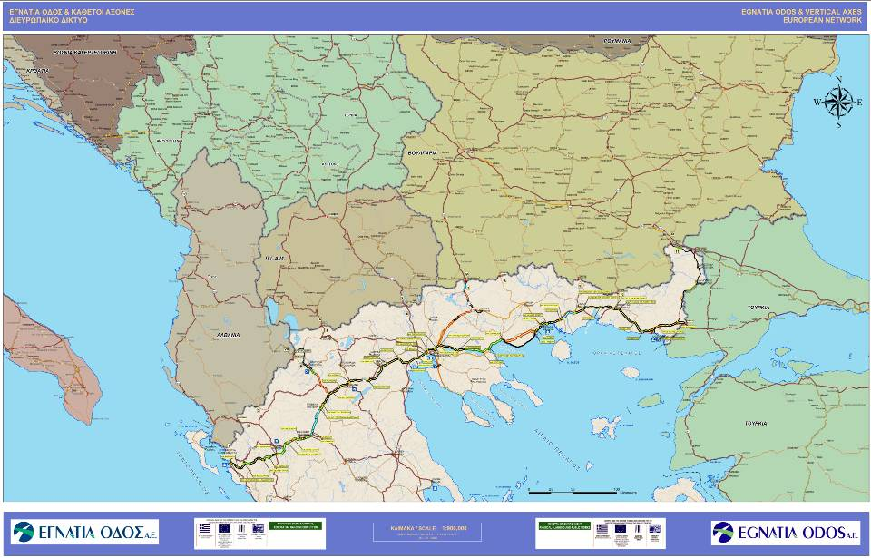

Slide 31
PROJECT IDENTITY

Slide 32
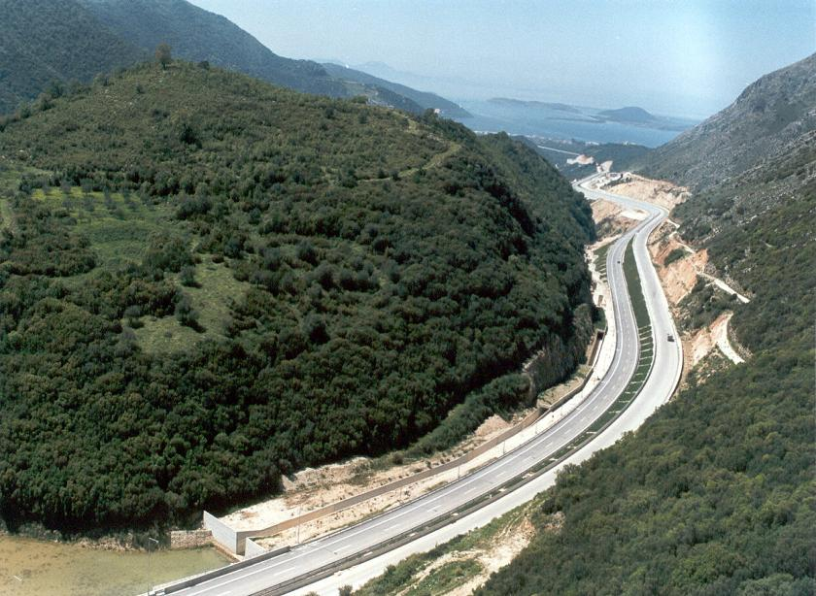
EPIRUS : LADOHORI – LIKOPODI

Slide 33
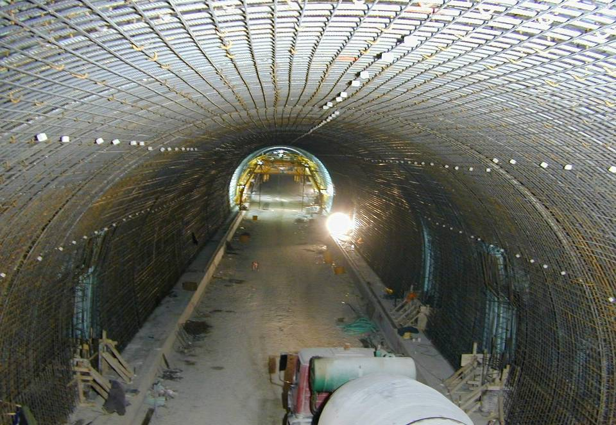
EPIRUS: DODONI TUNNEL

Slide 34
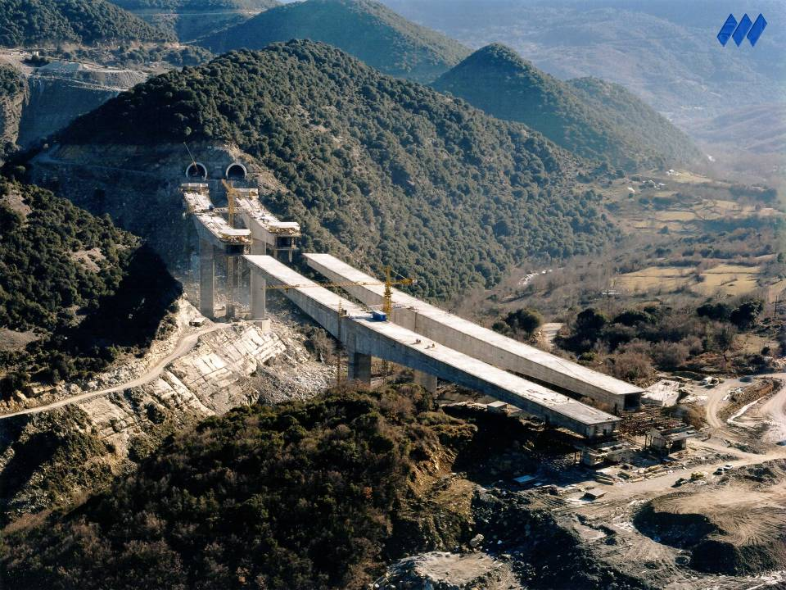
EPIRUS: VOTONOSI BRIDGE & TUNNEL

Slide 35
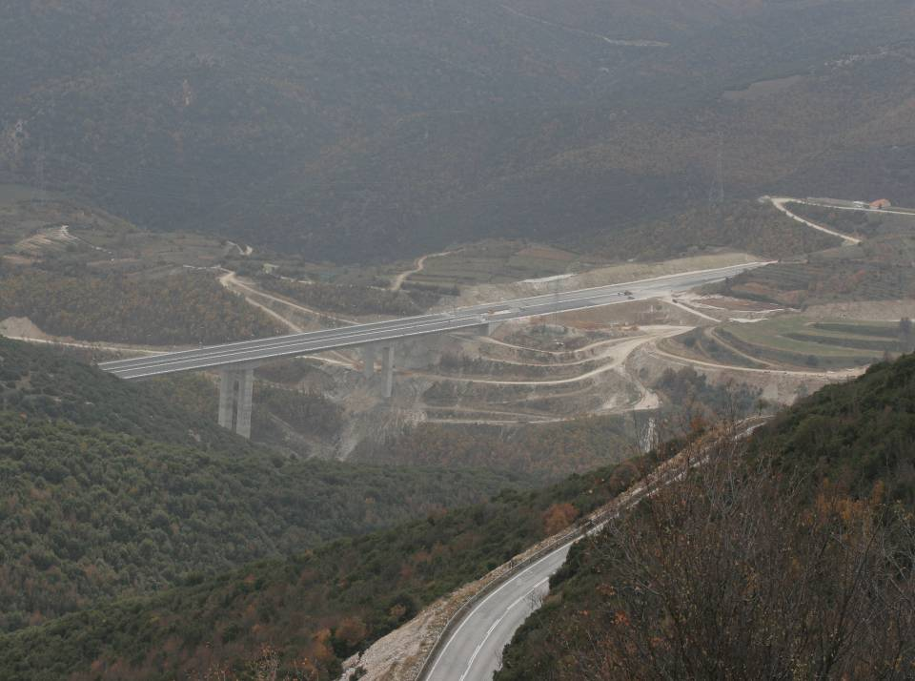
CENTRAL MACEDONIA: KASTANIA BYPASS

Slide 36
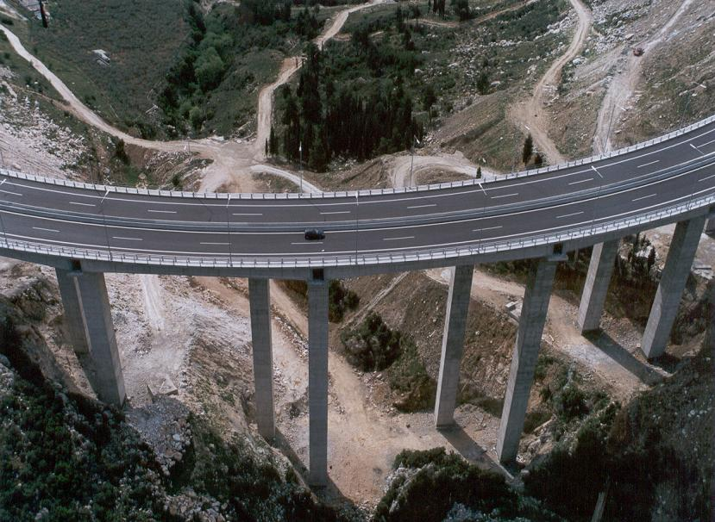
EAST MACEDONIA : KAVALA BYPASS - RAVINE BRIDGE

Slide 37
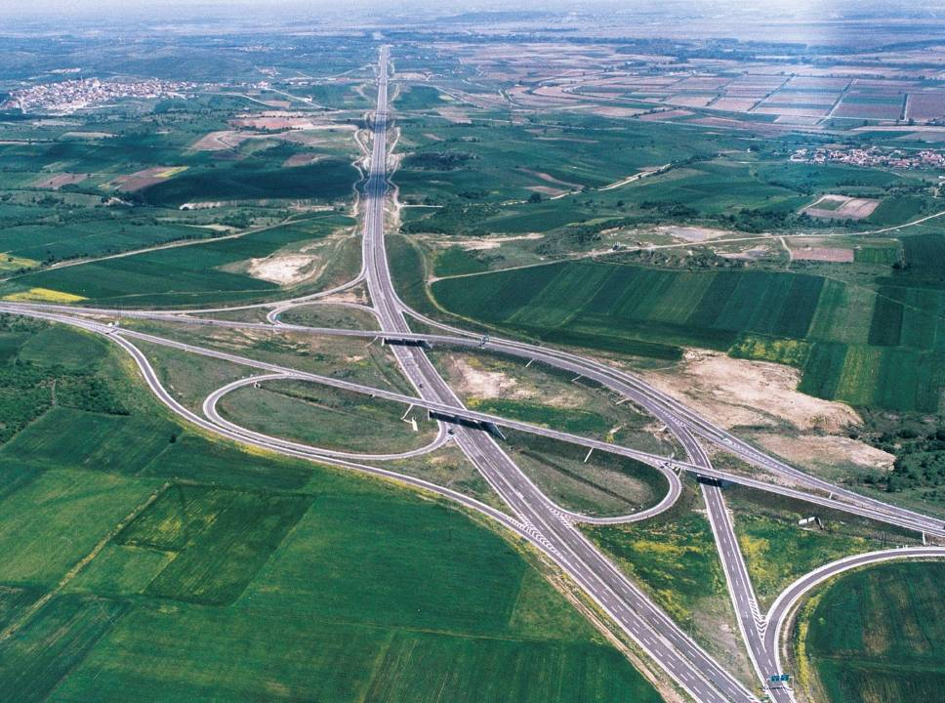
THRACE : ARDANIO I/C

Slide 38
REDUCTION OF TIME PER SECTOR

Slide 39
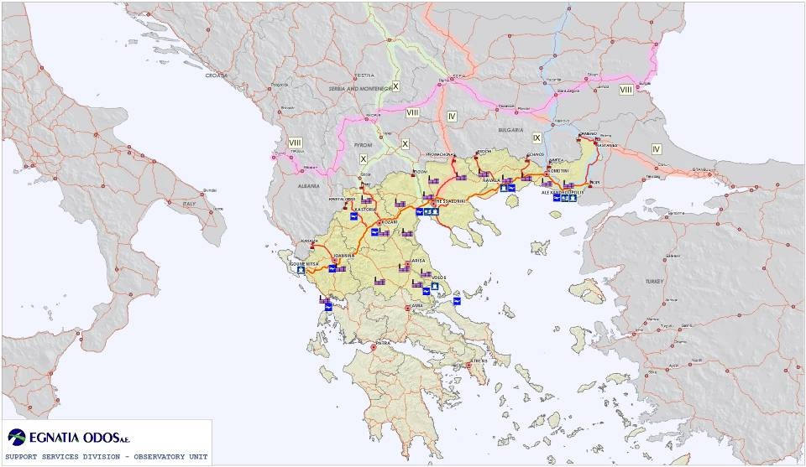
Egnatia Odos and Development:
Impact Zone

Slide 40
Egnatia Odos Impact Zone:
Main Characteristics
  50% of the Greece’s total area
  36% of the Greek population
  33% of the country’s total GDP
  60% of the country’s total energy production
  45% of the country’s exports
  35% of the country’s workforce
  69% of EU25 average GDP per inhabitant
Raw Data Sources: Greek National Statistics Agency, EUROSTAT
Data Analysis: Observatory Unit, Egnatia Odos S.A.

Slide 41
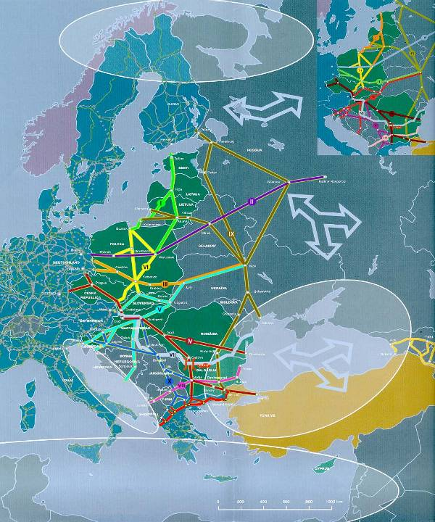
Pan European
Corridors

Slide 42
VERTICAL AXES
The Egnatia Motorway is served by 9 vertical axes. Five of these feeder routes constitute an extension of the Pan-European Corridors.
The Vertical Axes are:
Ioannina – Kakavia (Αlbania – Trans-European Axis)
Siatista – Krystallopigi (Αlbania – Trans-European Axis)
Kozani – Florina – Niki (FYROM – Pan-European Corridor Χ)
Thessaloniki – Evzonoi (FYROM – Pan-European Corridor Χ)
Thessaloniki – Serres – Promachonas (Βulgaria – Pan-European Corridor ΙV)
Drama – Nevrokopi – Εxochi (Βulgaria)
Xanthi – Εchinos (Βulgaria)
Komotini – Νymfaia (Βulgaria – Pan-European Corridor ΙΧ)
Ardanio – Ormenio (Βulgaria – Pan-European Corridor ΙΧ)

Slide 43
COST ANALYSIS
Construction
80%
Project
Management
7%
Design
Expropriations
5%
8%
TOTAL COST OF MAIN AXIS
4.600 M€ (without VAT) (5.400 Μ€ with VAT)

Slide 44
COST OF THE PROJECT
From a total length of 393 km. .......... the average cost is 4,5 M € / km.
  in flat and semi-mountainous terrains 3,4 M€ /km
  in mountainous areas with bridges and tunnels 15 M€/km
Estimated for 527 km ………………… the average cost is 7 M € / km
Construction cost for:
Twin deck bridges …………………………14 - 20 M € / Km
Twin bore tunnels…………………………. 20 - 30 M € / Km

Slide 45
FUNDING PROGRAMME
 | Length in Kms
Sections constructed during previous periods before 1994 | 94
PROJECTS AFTER 1997
2nd and 3rd CSF (ERDF) | 321
1st and 2nd Cohesion Fund | 206
New Projects (ERDF) | 59
TOTAL AXIS | 680
527

Slide 46
FUNDING RESOURCES
2000
2000
-
-
2006
2000
2006
2000
-
-
2006
1994
2006
1994
–
–
1999
1994
1999
1994
–
–
1999
1999
2400 M€
1410 M€
(without VAT
)
)
)
(without VAT)
50%
EU
50%
50%
Ε
50%
ΕU
60%
Ε
60%
Ε
60%
60%
ΤΣ
ΤΣ
CF
GR 50%
GR 50%
GR 50%
ΤΣ
GR 50%
ΤΣ
GR 40%
CF
GR 40%
GR 40%
GR 40%
493
493
493
ΕΤΠΑ
ΕΤΠΑ
315
ERDF
315
315
674
674
ΕΤΠΑ
674
ΕΤΠΑ
ERDF
ΔΔΜ
ΔΔΜ
MIΡ
33 M
33 M
33 Μ €
€
€
€
535
€
535
535
ΕΛΛΗΝΙΚΟ ΚΡΑΤΟΣ
GR STATE
ΕΛΛΗΝΙΚΟ ΚΡΑΤΟΣ
ΕΛΛΗΝΙΚΟ ΚΡΑΤΟΣ
GR STATE
ΕΛΛΗΝΙΚΟ ΚΡΑΤΟΣ
1200
1200
560
1200
560
560
ΕΛΛΗΝΙΚΟ
ΕΛΛΗΝΙΚΟ
GR STATE
ΚΡΑΤΟΣ
ΚΡΑΤΟΣ
ERDF
ΕΤΠΑ
550
ΕΤΠΑ
600
600
200
200
250
Additional Resources
TOTAL COST: 4600 M€
EU: 2300 Μ€
2004
2008
2004
-
2004
-
2008
2004
-
-
2008
2008
800
800 M€
800
(
(
(without VAT)

Slide 47
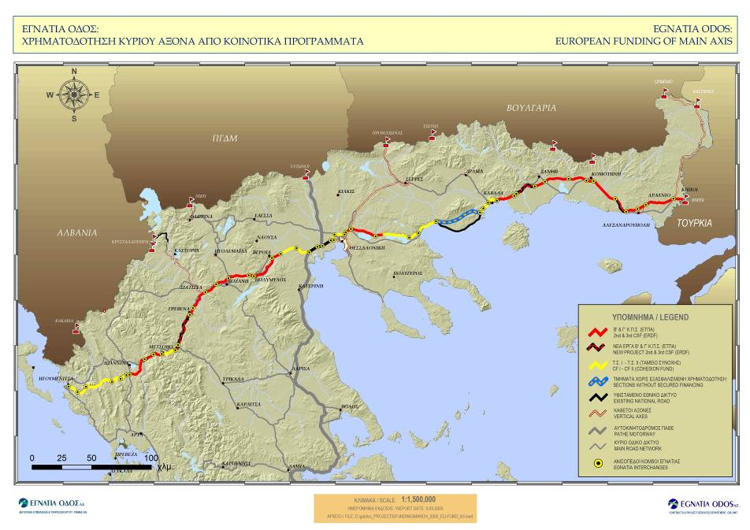

Slide 48
THE COMPANY
Legal Framework
  2nd CSF implementation guidelines
  Greek law 2229/94, article 5
Established in 1995
Commencement of Operation – 1996
  Appointment of GM, PM
Undertaking full Responsibility for the project in February 1997
Notes:
Telematics (sub)systems for Kavala Bypass
traffic monitoring
incident management
weather conditions monitoring
motorists advisory
data collection
(Παρακολουθηση φωτισμου και γεωτεχνικων χαρακτηριστικων)

Slide 49
COMPANY STRUCTURE
Managed by a 9-member BoD and a 5-member Managing Committee
With the participation of External Consultants:
      Project Manager
      3 Construction Managers
Personnel : 283 employees
      65% engineers
      35% administrative staff
Notes:
Telematics (sub)systems for Kavala Bypass
traffic monitoring
incident management
weather conditions monitoring
motorists advisory
data collection
(Παρακολουθηση φωτισμου και γεωτεχνικων χαρακτηριστικων)

Slide 50
ORGANISATION CHART
BOARD OF DIRECTORS
MANAGING COMMITTEE
TECHNICAL COUNCIL
COMMUNICATION COMMITTEE
CONCILIATION COMMITTEE
PUBLIC RELATIONS
INTERNAL AUDIT
PARLIAMENTARY AUDIT – CITIZENS REQUESTS -
PRESS
OBSERVATORY COMMITEE
GENERAL MANAGER
LEGAL SERVICE
GENERAL MANAGEMENT COUNCIL
PROJECT MANAGER
WORKS DIVISION
OPERATION – EXPLOITATION – MAINTENANCE DIVISION
SUPPORT SERVICES DIVISION
DESIGN DEPT
CONSTRUCTION MANAGEMENT SERVICE
CONTRACTS & PROJECT SERVICES DPT
PROJECT MANAGER EPIRUS
WORKS MANAGEMENT DPT EPIRUS
.
ROAD NETWORK MANAGEMENT DPT
FINANCIAL DEPT
PROJECT MANAGER MACEDONIA & THRACE
WORK MANAGEMENT DPT WEST MACEDONIA
ROAD NETWORK SUPPORT DPT
HUMAN RESOURCES & MANAGEMENT SUPPORT DPT
.
WORK MANAGEMENT DPT EAST MACEDONIA & THRACE
EXPLOITATION DEPT
.
-

Slide 51
MANAGEMENT FRAMEWORK
Regulation for the award and execution of works and designs (Directive 92/50,93/37, L.1418/84,716/77)
Purchasing Regulation (Directive 93/36)
Quality management system
(EN ISO 9001 : 2000)

Slide 53
IMPLEMENTATION OF WORKS
Organisational initiatives-innovations
Design
    Guidelines for Conducting Road Work Designs (OSMEO)
Landscape Restoration Guidelines (OSAT)
    Use of Checkers
    Geotechnical Investigations
    Use of Experts
    External Design Managers
Notes:
Telematics (sub)systems for Kavala Bypass
traffic monitoring
incident management
weather conditions monitoring
motorists advisory
data collection
(Παρακολουθηση φωτισμου και γεωτεχνικων χαρακτηριστικων)

Slide 54
IMPLEMENTATION OF WORKS
Organisational initiatives-innovations
Tender
    Descriptive price list for 900 highway items by applying a uniform pricing policy for all contracts )
    Standardization of tender documents and specifications
Notes:
Telematics (sub)systems for Kavala Bypass
traffic monitoring
incident management
weather conditions monitoring
motorists advisory
data collection
(Παρακολουθηση φωτισμου και γεωτεχνικων χαρακτηριστικων)

Slide 55
IMPLEMENTATION OF WORKS
Quality Assurance System
Monitoring project construction quality
Health and Safety at work
Insurance of Designs and Construction
Inviting Experts on Design and Construction Problems
Notes:
Telematics (sub)systems for Kavala Bypass
traffic monitoring
incident management
weather conditions monitoring
motorists advisory
data collection
(Παρακολουθηση φωτισμου και γεωτεχνικων χαρακτηριστικων)

Slide 56
SUPPORT SERVICES
    Project Control
        Progress Monitoring Systems (cost & time)
    Geographical Information System (GIS)
    Technical Document Control and Filing System
    Observatory of Spatial Environmental and Transport Impacts

Slide 57
SUPPORT SERVICES
    Monitoring of Community Financing Programmes
        Projects Bulletins
        Funding Flow
        Proposals for the MEPPW Investment Programme
        Information to Managing Authorities
        Information to the European Investment Bank

Slide 58
AUDITS
External Audits
      E.U funding bodies
      Public Sector bodies
      Private Sector bodies authorized by the Greek State
Internal audits
      Through the quality management systems
      Through internal auditors

Slide 59
ANNUAL DRAWDOWN
(in M€, after revision and with VAT)
Commencement of the Project Management by EOAE on February
Commencement of the additional funding program

Slide 60
TOTAL CSF DRAWDOWN
(in M€, after revision and with VAT)
(31/12/2003)
(31/12/2002)
(31/12/2001)
(31/12/2000)
Available resources from 2nd CSF
to be absorbed by the end of 2001

Slide 61
OPEN-TO-TRAFFIC PROGRAMME
 | Length in Kms
Sections constructed during previous periods before 1994 | 94
PROJECTS AFTER 1997
Completed and opened to traffic (December 2004) | 393
Other sections under construction | 133
Sections under tender | 59
TOTAL AXIS | 680

Slide 62
Geographical distribution of new road sections opened by the end of 2004
Epirus | 45km
Western Macedonia | 88km
Central Macedonia | 86km
Eastern Macedonia & Thrace | 174km
TOTAL | 393km
The rate of delivering road sections to traffic
from 1997 until today is ~56 km/year

Slide 63
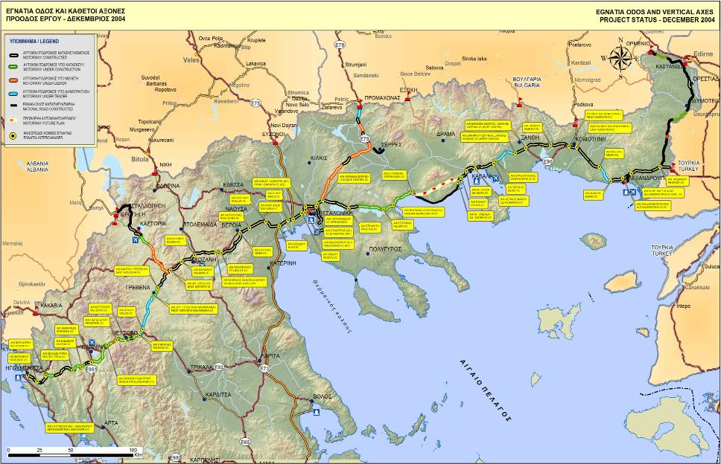

Slide 64
IMPLEMENTATION OF A QUALITY ASSURANCE SYSTEM FOR TRAINING IN ORGANIC FOOD RETAIL – EcoQualify III
Project Activities and Products achieved during the 1st year
LIFELONG LEARNING PROGRAMME
LEONARDO DA VINCI TRANSFER OF INNOVATION
2010-1-GR1-LEO05-03967

Slide 65
Project Activities and Products achieved during the 1st year
(01.10.2010 – 30.09.2011)
15.09.2011

Slide 66
Activity 1
WP1 - Project management and administration
15.09.2011

Slide 67
Coordinator general activities
The University of Thessaly represented by Prof. S. Tzortzios, as general Contractor and Coordinator of this project, during the 1st year was responsible for the general management as well as the successful implementation of the EcoQualify III project activities, especially:
Undertaking the daily project management by
    Daily communication and regular contact with other project partners
    On-line exchange of data for checking progress
    Explanation of the organizational and financial process requirements to all partners
    Daily bookkeeping
2. Organizing and facilitating meetings in Vienna, Plovdiv and Turkey
15.09.2011

Slide 68
Coordinator general activities
3. Financial and administrative management
  payroll,
  project accounting and
  preparing / completing the project's financial tables
  budget control through regularly updated financial table
4. Translation of the products into Greek language
5. Internal running monitoring
6. Dissemination of results and implementation of the valorisation strategy
15.09.2011

Slide 69
WP1 - Project management and administration- Products
Development of the project management Strategy and methodology
  in order to ensure completion of the tasks on time, within cost and to required quality standards, according to the planed budget and in compliance with the Administrative and Financial Rules of LLP.
Quality Management Plan
3. Project Management Board (PMB)
    Nominating project managers from each partner
4. Work Plan and Working Packages organization for the 1st year
In 1st meeting in Vienna 18th-19th November 2010 was organized project activities for the first year
15.09.2011

Slide 70
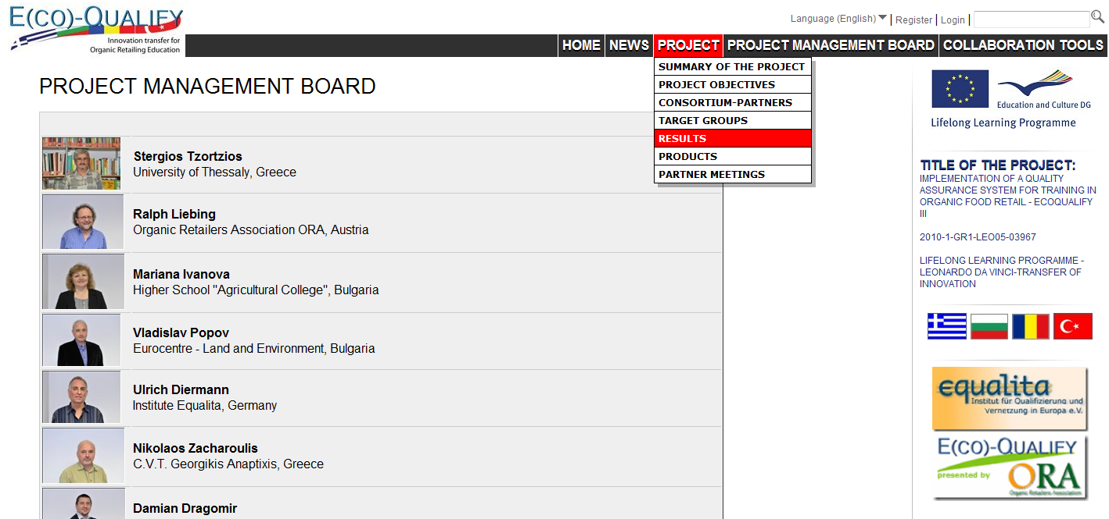
15.09.2011

Slide 71
WP1 - Project management and administration- Products
5. Website of EQIII project
A website for EQIII project was designed and developed by the team of the University of Thessaly and since December 20, 2010 the EQ III page is up and hosted at the server of our university at the following address: http://ecoqualifyiii.uth.cs.teilar.gr/home/.
  The project home page contains an internal area that allows:
  easy access and communication between the partners
  progress on work-packages or individual tasks to be reviewed and monitored
  proactive management and communication through e-mail and virtual conferences
Development of the website’s texts primarily was in English
Since 28.02.2011 partners translated the website’s texts in their national languages and there are website sections in English, Bulgarian, Greek, Romanian and Turkish language.
Design of the front page and other pages of website on 15/2/2011
The project website is updated with all the information we have received so far in order to promote Eco-Qualify III project, its objectives, activities, target groups, partners and results.
15.09.2011

Slide 72
WP1 - Project management and administration- Products
6. ADAM portal
Since 15 March 2011, after Project’s submitting and validation, the project was available in public on ADAM portal (http://www.adam-europe.eu/) .
ADAM has been used from LDV Project team in order to:
  to make the Eco-Qualify III project available to the scientific community
  to disseminate its results in a variety of formats that can be viewed by many different organizations across Europe. Currently all functions are available in English, German and French.
  Access to the ADAM portal
The project operator in ADAM can give other people the right to edit this project.
  If this person is already known in ADAM, the operator can simply enter his e-mail address, while
  If this person is not known, he can enter his data in the form and submit.
  The person will receive an e-mail with a password and a link to this project.
Our ADAM project page will be continuously updated with upcoming events, new products and files available to the public.
15.09.2011

Slide 73
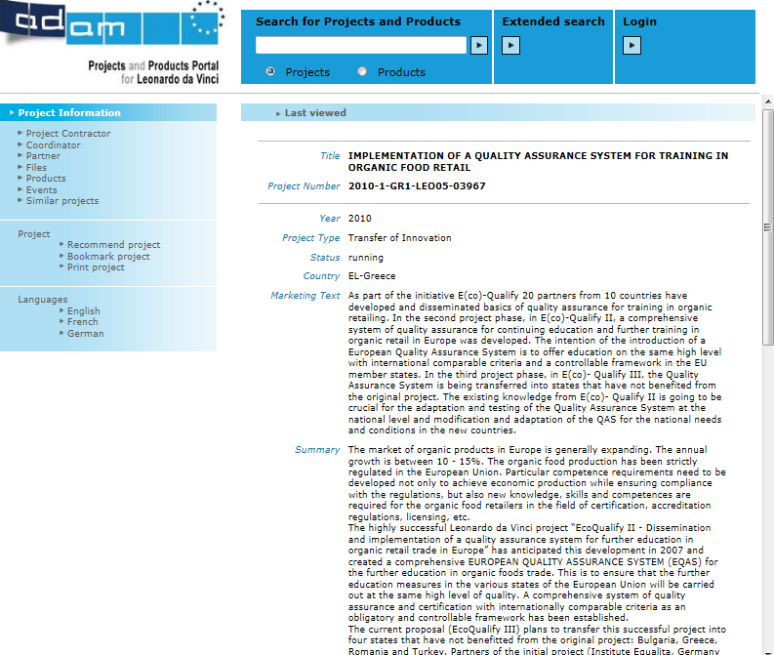
ADAM portal
15.09.2011

Slide 74
WP1 - Project management and administration- Products
  7. Dropbox tool
  For the projects necessities, a file named
“ECO-QUALIFY III GR-GB-RO-TK was created by Mr. Ralph Liebing on DROPBOX in order to share common files in the frame of the project.
  Since 26.11.2010 we have signed in Dropbox and since then we have uploaded presentations (PPT files) of the meetings in Vienna and Plovdiv, the Frame work Analysis report, Flyer draft in Greek version e.t.c., in order to share these files with each other.
15.09.2011

Slide 75
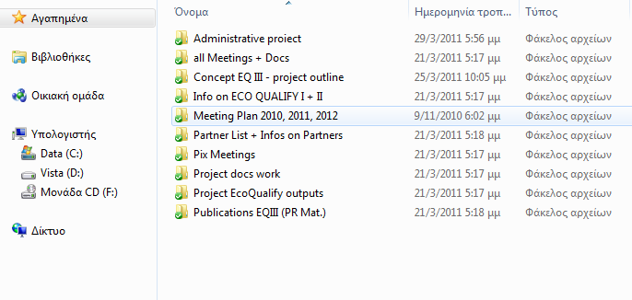
Dropbox tool
The contents of ECOQUALIFY III file
15.09.2011

Slide 76
Activity 2
WP2 – Framework Analysis
15.09.2011

Slide 77
WP2 – Framework Analysis
Activities
Feedback on the questionnaires for consumers, farmers and retailers designed by Mrs. M. Ivanova and Mr. Ulrich Diermann on December 2010 for interviews of experts and stakeholders.
Translation of the questionnaires to our national language.
Interviewing consumers, producers and retailers by face-to-face questioning in collaboration with the P5 partner (C.V.T G.A.), in order to be contributed to the national surveys to this work package.
50 consumers, 20 producers and 5 retailers were interviewed.
Questionnaires data were statically analyzed up to 15/2/2011
15.09.2011

Slide 78
WP2 – Framework Analysis
Product: Frame work analysis report
  The frame work analysis report was completed on 25.02.2011 including the market research results and the interview outcomes on the current state of organic food retailing in our country, information on the respective legislation and inspection conditions e.t.c.
  The results of the Framework Analysis were up loaded to Dropbox and presented in the results of the Framework Analysis in the 2nd transnational meeting of the project which hold in Bulgaria on 28th – 29th of April 2011.
15.09.2011

Slide 79
Activity 3
WP3 - Adaptation of Quality Assurance System for training in organic foods retailing to the national requirements
15.09.2011

Slide 80
WP3 - Adaptation of Quality Assurance System for training in organic foods retailing to the national requirements
Activities
1.Exanimation of the existing content and functional design of the Quality Handbook (QH) in order to be adapted according to our linguistic, pedagogical and social-economic requirements to the local conditions in Greece.
2.Translation of the QH text to our language
Products
1.Comments on QH content were suggested concerning the area of:
  product knowledge,
  store operations and
  marketing
according to our local needs and requirements sent to Nazan Cevik on 30/6/2011.
2. QH in Greek edition
15.09.2011

Slide 81
Activity 6
WP6 - Valorization and dissemination
15.09.2011

Slide 82
Dissemination activities
Advertisement of the Leonardo da Vi nci Project has been done through:
  Project website Eco Qualify III (http://ecoqualifyiii.uth.cs.teilar.gr/home/)
  A visitor counter TOOL was installed on the website in order to follow the visitor traffic.
  University of Thessaly
  Technological Educational Institutions of Larisa
  Producers and retailers of organic food
  Zootechnia 2011: 7th INTERNATIONAL FAIR FOR LIVESTOCK & POULTRY
  that took place at International Exhibition Center Of Thessaloniki, Thessalonica in 3-6 February 2011 (dissemination of the Flyer draft).
  21st International Exhibition of Food, Beverages, Equipment & Machinery
  that took place at Thessaloniki International Exhibition Centre in 11 - 14, March 2011 (dissemination of the Flyer draft).
15.09.2011

Slide 83
Dissemination activities
Young Researchers Winter School (YRWS)-www.efita.eu
that took place at Karpenisil, Greece, in 31.3.-3.4.201. Prof. S. Tzortzios on his announcement “Agriculture and Environment- Agricultural application and European Projects” present project aims, tasks and the possibilities.
5th International Conference on Information and Communication Technologies in Agriculture, Food and Environment (HAICTA 2011).
that took place in Skiathos Island, Greece in September 8-11, 2011, with the announcement “Applications of Informatics in a LdV project with reference to the organic farming in Greece and Europe” by Gousios, V., Tziortziou Ath., Vlontzos G., Nakas Chr., and Tzortzios St..
15.09.2011

Slide 84
Flyer draft
Activities
Feedback on organic agriculture in Greece and the progress of organic food retail were prepared on 01.12.2010, in the frame of Flyer draft development .
Original pictures from our local market of biological products were sent to Mrs Marianna Ivanova and were uploaded to Dropbox.
Translation of the flyer’s draft text in our native language (11/2/ 2011 to 13/2/2011).
The Greek version of Flyer draft was uploaded to Dropbox since 14/2/2011.
Final correction on the Greek version of flyer draft on 10/5/2011.
Product
15.09.2011

Slide 85
Dissemination activities
  Also flyer draft have been distributed to:
    Agricultural Biological Organizations,
    Agricultural Biological Co-operators as well as
    A meeting was organised …(date)……..with the Minister of Rural Development and Food in order to inform him about the project aims, tasks and the possibilities.
    Natural shops
    retailers/farmers
    organisations in the field of organic production and marketing
    Publications in media
15.09.2011

Slide 86
Valorization activities
The 1st report on the project progress was prepared on 3.3.2011 reported the process or the project during the period from 1.10.2010 to 28.2.2011.
Also the Interim report is in process and will be completed at the end of September 2011.
15.09.2011

Slide 87
Marketing Aspects of Quality Assurance Systems
The Organic Food Sector Case

Slide 88
Effect of quality assurance systems on business performance
How a quality assurance system can be utilized as a determinant factor of a firm’s marketing strategy

Slide 89
Design/methodology/approach
Based on literature and the quality theory:
types of goods according to their quality attributes
benefits of participating in a quality award procedure
how a quality assurance system affect on firms’ performance
factors that determine consumers’ willingness to pay a price premium for organic products.

Slide 90
Findings
Better quality conformance associated with sales growth and better sales margins
A quality certification increases market share and provides access to new market
The key to define quality is consumers: a company’s internal definition of quality must reflect consumers’ requirements

Slide 91
Important determinants for consumers’ willingness to pay a price premium to buy organic food products
socio-demographic characteristics
perceived quality
risks

