Slide 1

GLOBAL OVERVIEW AND THE PERFORMANCE OF GREEK UNIVERSITIES
Ben Sowter
Head of Division, QS Intelligence Unit
September 2012

Slide 2
Rankings have many faults and do not adequately describe universities and cannot show whether one institution is better than another…
…but I am very happy when Cambridge is rated as the top university in the world
Alison Richard
Former Vice-Chancellor, University of Cambridge
Notes:
Also mean’s that around 10% of international students are studying at the world’s top 0.5% of universities

Slide 3
2003
Shanghai Rankings emerge
2004
QS (initially with THES) and Webometrics Rankings launched
2005
Employer component added to QS ranking
2007
HEEACT ranking published for the first time
2009
2010
QS University Rankings: Asia launched
URAP rankings begin
2010
Times Higher Education go their own way
October 2011
February 2012
QS University Rankings: Latin America launch
QS Best Student Cities published
June 2012
Improved subject tables extended to embrace 29 disciplines

Slide 4


Slide 5

To ENABLE motivated people
around the WORLD
achieve their POTENTIAL by
fostering international MOBILITY, educational ACHIEVEMENT
and career DEVELOPMENT

Slide 6
Student Challenges
Higher education costs increasing
Number of students increasing
Number of international students increasing
More universities actively recruiting
Flooded with information
Employers increasingly dissatisfied with graduate skill sets
Need for discernment
Need for navigation tools

Slide 7
International Student Growth

Slide 8
FASTEST GROWING DESTINATIONS

Slide 9
Our Approach
Research Quality
Teaching Quality
A UNIQUE LENS
QS the only global ranking authority to consider it
Central to the life goals of most prospective students
An essential inclusion in every QS assessment
World Class University?
Graduate Employability
International Outlook

Slide 10
Indicators
Academic Reputation
Faculty Student
Citations per Faculty
Employer Reputation
International Faculty
International Students

Slide 11
2012 HIGHLIGHTS
46,079 academic respondents
25,564 employer respondents
729 institutions ranked
72 countries overall
32 countries in top 200
19m students at ranked institutions
16m self-citations excluded
1m visits in first week
Avg change in position:
  Top 100 – 4.6 places
  Top 200 – 9.1 places
Top 100 an average of 7 years younger than 2010
9.2% growth in international students at top 200
35% of all international students at top 3% of institutions

Slide 12

2012-2013: TOP 20
1 |  | Massachusetts Institute of Technology (MIT) |  | 1
2 |  | University of Cambridge |  | 2
3 |  | Harvard University |  | 3
4 |  | UCL (University College London) |  | 4
5 |  | University of Oxford |  | 5
6 |  | Imperial College London |  | 6
7 |  | Yale University |  | 7
8 |  | University of Chicago |  | 8
9 |  | Princeton University |  | 9
10 |  | California Institute of Technology (Caltech) |  | 10
11 |  | Columbia University |  | 11
12 |  | University of Pennsylvania |  | 12
13 |  | ETH Zurich (Swiss Federal Institute of Technology) |  | 13
14 |  | Cornell University |  | 14
15 |  | Stanford University |  | 15
16 |  | Johns Hopkins University |  | 16
17 |  | University of Michigan |  | 17
18 |  | McGill University |  | 18
19 |  | University of Toronto |  | 19
20 |  | Duke University |  | 20

Slide 13
INSTITUTIONS IN TOP 200

Slide 14
Comparing Methodologies
ARWU (2003)
QS (2004)
WEBOMETRICS (2007)
THE (2010)

Slide 15
Comparing Results
 | ARWU | QS | Webometrics | THE
1 | Harvard | MIT | Harvard | Caltech
2 | Stanford | Cambridge | MIT | Harvard
3 | MIT | Harvard | Stanford | Stanford
4 | Berkeley | UCL | Berkeley | Oxford
5 | Cambridge | Oxford | Cornell | Princeton
6 | Caltech | Imperial | Minnesota | Cambridge
7 | Princeton | Yale | Pennsylvania | MIT
8 | Columbia | Chicago | Wisconsin | Imperial
9 | Chicago | Princeton | UIUC | Chicago
10 | Oxford | Caltech | Michigan State | Berkeley
August 2012
September 2012
July 2012
October 2011
Notes:
These are the top 10 in the four systems talked about earlier. When I went to get the new results for SJTU I had to make no changes to their list here. Their exercise is extremely static – the only way to easily influence it is to spend an obscene amount of money to hire Nobel Prize winners or highly cited authors. The top 27 or so in Webometrics are US institutions, the top 15 in HEEACT are US institutions. Ours is the most geographically diverse but still concludes that the US is where the majority of the world’s best universities are to be found.
58 of our top 200 are US institutions.

Slide 16





Digging Deeper
UNIVERSITY RANKINGS
26 subject tables in 2011
More anticipated for 2012
MORE SUBJECTS
QS Best Student Cities
MORE CONTEXTS
MORE DIMENSIONS

Slide 17

What is QS Stars?
A way to address many criticisms of rankings
A broad based rating system, designed to identify, evaluate and recognize universities for their diverse and specialist strengths.
Once evaluated, universities are awarded with a star rating, based on their performance.
Can include all universities—including those not in the rankings or low ranked
Benefits institutions looking to increase international presence

Slide 18
Points Available – 1000
Core Criteria
600
Learning Environment
100
Advanced Criteria
100
Teaching
6 indicators
150
Facilities
6 indicators
100
Innovation
3 indicators
50
+
OR
OR
Employability
3 indicators
150
Online/Distance
6 indicators
100
Culture
3 indicators
50
+
OR
Research
5 indicators
150
Access
4 indicators
50
+
Specialist Criteria
200
OR
Internationalization
7 indicators
150
Engagement
4 indicators
50
Discipline Ranking
2 indicators
150
+
Accreditation
2 indicators
50
Version 4.0
Notes:
Reason/justification for choice of indicators:
We have to pick things that are feasible to collect, we want to evaluate the broadest range of university activity that we can but keep the audit process feasible. It is likely other measures will b added in the future.
Allocation of points:
We have attempted to place a focus on the aspects of university strength that are considered conventionally more central – research, teaching etc. Then a read has been taken as to how effectively the indicator in question evaluates that aspect. To a certain extent the scores have been assigned based on the collective experience behind the Intelligence Unit – ... we have run this by a number of externals and presented in a number of places to seek feedback – which has been largely positive.

Slide 19
Though of course we recognize limitations of all league table methodologies, we greatly value QS for the clarity and quality of the data you use and for the stability which enables us to see and understand trends over time.
This, we think, gives your rankings a comparative advantage and considerable authority.
David Eastwood
Vice-Chancellor, University of Birmingham
Notes:
Also mean’s that around 10% of international students are studying at the world’s top 0.5% of universities

Slide 20
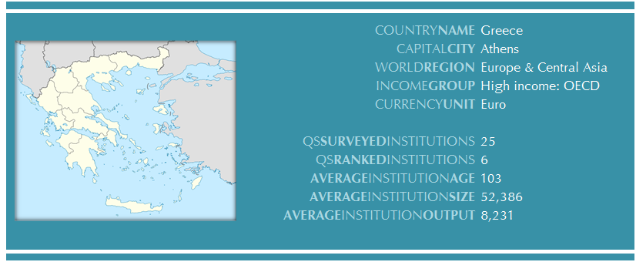
COUNTRY REPORT – GREECE
More than double the average for the world’s top 600

Slide 21
DEMOGRAPHICS & ECONOMICS

Slide 22
Representation in qs Surveys
QS Global Academic Survey
Count |  |  | 327
% Global |  |  | 0.7%
Avg years in academia |  |  | 20.3
Average seniority |  | Assistant Professor
Leaders |  |  | 44
Rank by response |  |  | 38
QS Global Employer Survey
Weighted Count |  |  |  | 547
% Global |  |  |  | 2.2%
Rank by response |  |  |  | 13
Average seniority |  |  | Other Human Resources
Most responsive sector |  |  | Manufacturing

Slide 23
QS CLASSIFICATIONS

Slide 24
Overall Rankings Performance
 | Institutions in Range |  |  | Average Rank
Range | 2012 | 2011 | Change | 2012 | 2011 | Change
1-100 | 0 | 0 | 0
101-200 | 0 | 0 | 0
201-300 | 0 | 0 | 0
301-400 | 0 | 1 | -1 |  | 387 |  | -1
401-500 | 2 | 2 | 0 | 475 | 483 | 8 | 0
501-600 | 2 | 2 | 0 | 532 | 572 | 40 | 0
601-700 | 2 | 1 | 1 | 654 | 636 | -18 | 0
Overall | 6 | 6 | 0 | 554 | 522 | -32 | -1

Slide 25
INDICATOR PERFORMANCE

Slide 26
QS SAFE
 |  | 2010 |  | 2011 |  | 2012
Aspect |  | Score | Rank | Score | Rank | Score | Rank
SYSTEM |  | 29.5 | 37 | 28.6 | 38 | 29.3 | 39
ACCESS |  | 91.8 | 7 | 86.2 | 8 | 58.0 | 25
FLAGSHIP |  | 44.4 | 36 | 25.8 | 43 | 20.1 | 49
ECONOMIC |  | 19.2 | 40 | 17.2 | 44 | 20.9 | 44
OVERALL |  | 46.2 | 31 | 39.5 | 37 | 32.1 | 42

Slide 27
Top Universities
Institution |  |  |  |  |  |  | 2012 | 2011
Aristotle University of Thessaloniki |  |  |  |  |  |  | 451-500 | 451-500
University of Crete |  |  |  |  |  |  | 451-500 | 451-500
National and Kapodistrian University of Athens |  |  |  |  |  |  | 501-550 | 387
National Technical University of Athens |  |  |  |  |  |  | 551-600 | 551-600
University of Patras |  |  |  |  |  |  | 601+ | 551-600
Athens University of Economics and Business |  |  |  |  |  |  | 601+ | 601+

Slide 28
FACULTY AREA PERFORMANCE

Slide 29
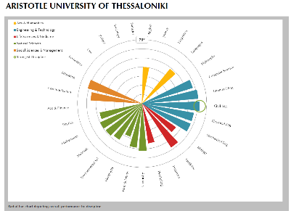
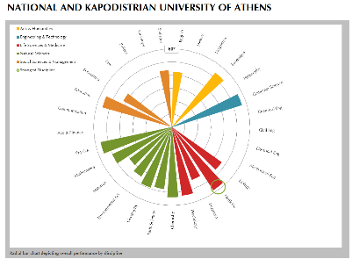
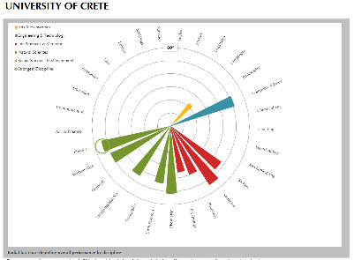
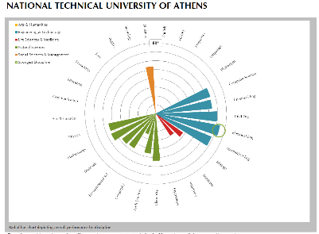
SUBJECT PROFILES

Slide 30






2012 Results
FEBRUARY
MAY
JUNE
SEPTEMBER
1,500 following live launch
Over one million direct visitors in week one
Results online at www.topuniversities.com
Detailed methodologies and survey response analysis at www.iu.qs.com

Slide 31
The list is the origin of culture…
How does one attempt to grasp the incomprehensible?
Through lists.
Umberto Eco
Essayist, Philosopher & Novelist
Notes:
Also mean’s that around 10% of international students are studying at the world’s top 0.5% of universities

Slide 32
Thank you
Results: www.topuniversities.com
Methodology & Comment: www.iu.qs.com
Twitter: @bensowter, @worlduniranking
Facebook: www.facebook.com/universityrankings
Email: ben@qs.com; intelligenceunit@qs.com

